Slide 1





GROUP 1
Amazon Website
Hesham Abdelazim
Abdelrahman Saaed
Ahmed Khalil
Philip Maher
Ahmed
Rafat

Slide 2

AGENDA
Introduction
Manual of 8 features
API Testing (Postman)
Automation (Selenium)
Questions

Slide 3
MANUAL TESTING of
AMAZON WEBSITE
User stories - Test cases - Test Results - finally the Bug report

Slide 4
REGISTER
USER STORY

Slide 5
Title | Description | Acceptance Criteria | Test Case ID
As a new visitor, I can register to create an account | Ensure Creating new accounts/clients successfully | ✓ Creating an account by providing my first name, last name, email address, and a secure password, ✓ I want to receive a verification email after registering. ✓ I want the website to enforce strong password requirements (e.g., minimum length, mixed characters) ✓ I want to receive a confirmation message after successfully registering. ✓ I want to be automatically redirected to my profile page or the website's main dashboard after registration | register-001 register-002 register-003 register-004 register-005 register-006 register-007 register-008 register-009 register-010

Slide 6
REGISTER
TEST CASES

Slide 7
Test Cases ID | Test Title | Pre Condition | Test Steps | Test Data | Expected Result | Actual Result | Status | Comments or Attachments
register-001 | A red rectangle appears after clicking on "Continue if no inputs | - | 1- Open URL https://www.amazon.eg/ 2- Click on "My Account & " link at the "Header" 3- Click on "Continue" button | - | The Registration/Sign in process stops and Red Rectangle appeared around the email field | Works as expected | Pass | -
register-002 | A red rectangle appears if wrong email structure | - | 1- Open URL https://www.amazon.eg/ 2- Click on "My Account & " link at the "Header" 3- Write on the email field wrong input (eg: Test123) 4- Click on "Continue" button | - | The Registration/Sign in process stops and Red Rectangle appeared around the email field | It works as expected | Pass | -
register-003 | the user proceed to the next layer of Registration | valid email structure | 1- Open URL https://www.amazon.eg/ 2- Click on "My Account & " link at the "Header" 3- Write on the email field valid input (eg: abc.ABC234@gmail.com) 4- Click on "Continue" button | email input | The user should proceed to the next page that has title "Looks like you're new to Amazon" | The red rectangle appeares not only after wrong inputs but Also, after clicking on "Continue" button | Pass | -
register-004 | If new visitor Email, The Register page will open | valid email structure and new E-mail | 1- Open URL https://www.amazon.eg/ 2- Click on "My Account & " link at the "Header" 3- Write on the email field valid input (eg: abc.ABC234@gmail.com) 4- Click on "Continue" button | email input | After valid New Register in the system the Register Form will open | It works as expected | Pass | -
register-005 | red rectangles around all empty fields after clicking on "Verify Mobile number" | new Registered user | 1- Open URL https://www.amazon.eg/ 2- Click on "My Account & " link at the "Header" 3- Write on the email field valid input (eg: abc.ABC234@gmail.com) 4- Click on "Continue" button 5- Click on "Proceed to create an account" button 6- Click on "Verify mobile number" button | Form inputs | All fields surrounded by Red Rectangle | It works as expected | Pass | -

Slide 8
Test Cases ID | Test Title | Pre Condition | Test Steps | Test Data | Expected Result | Actual Result | Status | Comments or Attachments
register-006 | incorrect Egyptian number leads to red rectangle around the number field | new Registered user | 1- Open URL https://www.amazon.eg/ 2- Click on "My Account & " link at the "Header" 3- Write on the email field valid input (eg: abc.ABC234@gmail.com) 4- Click on "Continue" button 5- Click on "Proceed to create an account" button 6- Write the "1111111111" in the mobile field 7- Click on "Verify mobile number" button | Phone Number | Red rectangle is expected | the incorrect number in the Phone field is valid and no red rectangle | Fail | Attachment
register-007 | Numbers in the Name field leads to red rectangle around the field | new Registered user | 1- Open URL https://www.amazon.eg/ 2- Click on "My Account & " link at the "Header" 3- Write on the email field valid input (eg: abc.ABC234@gmail.com) 4- Click on "Continue" button 5- Click on "Proceed to create an account" button 6- Write the "1111111111" in the Name field 7- Click on "Verify mobile number" button | Name input | Red rectangle is expected to be around the Name field | the number input in the Name field is valid and no red rectangle | Fail | Attachment
register-008 | Weak Password that has only numbers and more than 6 characters | new Registered user | 1- Open URL https://www.amazon.eg/ 2- Click on "My Account & " link at the "Header" 3- Write on the email field valid input (eg: abc.ABC234@gmail.com) 4- Click on "Continue" button 5- Click on "Proceed to create an account" button 6- Write the "1111111111" in the Password field 7- Click on "Verify mobile number" button | Password | Red rectangle is expected to be around the Password field | the numbers input and more than 6 characters is valid in the Password field and no red rectangle | Fail | Attachment

Slide 9
Hesham
Test Cases ID | Test Title | Pre Condition | Test Steps | Test Data | Expected Result | Actual Result | Status | Comments or Attachments
register-009 | Re enter Password leads to red rectangle if mismatch with password field | new Registered user | 1- Open URL https://www.amazon.eg/ 2- Click on "My Account & " link at the "Header" 3- Write on the email field valid input (eg: abc.ABC234@gmail.com) 4- Click on "Continue" button 5- Click on "Proceed to create an account" button 6- Write the "1111111111" in the Re-enter Password field 7- Click on "Verify mobile number" button | Password | Red rectangle is expected to be around the Password field | It works as expected | Pass | -
register-010 | Valid inputs of the Register form make valid Registration Process |  | 1- Open URL https://www.amazon.eg/ 2- Click on "My Account & " link at the "Header" 3- Write on the email field valid input (eg: abc.ABC234@gmail.com) 4- Click on "Continue" button 5- Click on "Proceed to create an account" button 6- Write the "1111111111" in the Re-enter Password field 7- Click on "Verify mobile number" button | all Registering form inputs | Registering successfully | It works as expected | Pass | -

Slide 10
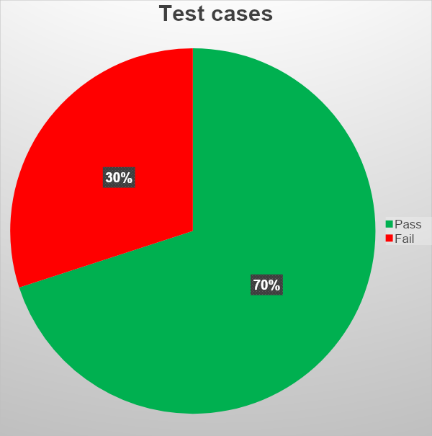
TEST CASE RESULTS REGISTER
Out of 10 test cases related to registration we found 3 bugs.

Slide 11
LOGIN
USER STORY

Slide 12
Title | Description | Acceptance Criteria | Test Case ID
As a visitor, I want to log in to my account | Ensure Authentication of the user to proceed with features | ✓ I can write my registered mail and Password. ✓ I want to see Error message, When I write wrong Email/Password. ✓ I want to receive an e-mail after clicking on "forgot password". | login-001 login-002 login-003

Slide 13
LOGIN
TEST CASES

Slide 14
Test Cases ID | Test Title | Pre Condition | Test Steps | Test Data | Expected Result | Actual Result | Status | Comments or Attachments
login-001 | a red rectangle appeared around the password field of the "Continue Login " page | Registered Email is used | 1- Open URL https://www.amazon.eg/ 2- Click on "My Account & " link at the "Header" 3- Write on the email field valid input (eg: heshamabdelazim43@gmail.com) 4- Click on "Continue" button 5- Click on "Continue" button | Password | Red Rectangle should appear around the Password field | Works as expected | Pass | -
login-002 | An OTP Page open after successful auth | Registered Email is used | 1- Open URL https://www.amazon.eg/ 2- Click on "My Account & " link at the "Header" 3- Write on the email field valid input (eg: heshamabdelazim43@gmail.com) 4- Click on "Continue" button 5- Write the related Password of that email 6- Click on "Continue" button | Password | The OTP page should open | Works as expected | Pass | -
login-003 | After input of OTP the user goes to the homepage | Registered Email and its related Password are used | 1- Open URL https://www.amazon.eg/ 2- Click on "My Account & " link at the "Header" 3- Write on the email field valid input (eg: heshamabdelazim43@gmail.com) 4- Click on "Continue" button 5- Write the related Password of that email 6- Click on "Continue" button 7- Enter the OTP sent to the phone and continue | Password and OTP | after valid OTP the user will be redirected to the homepage | Works as expected | Pass | -

Slide 15
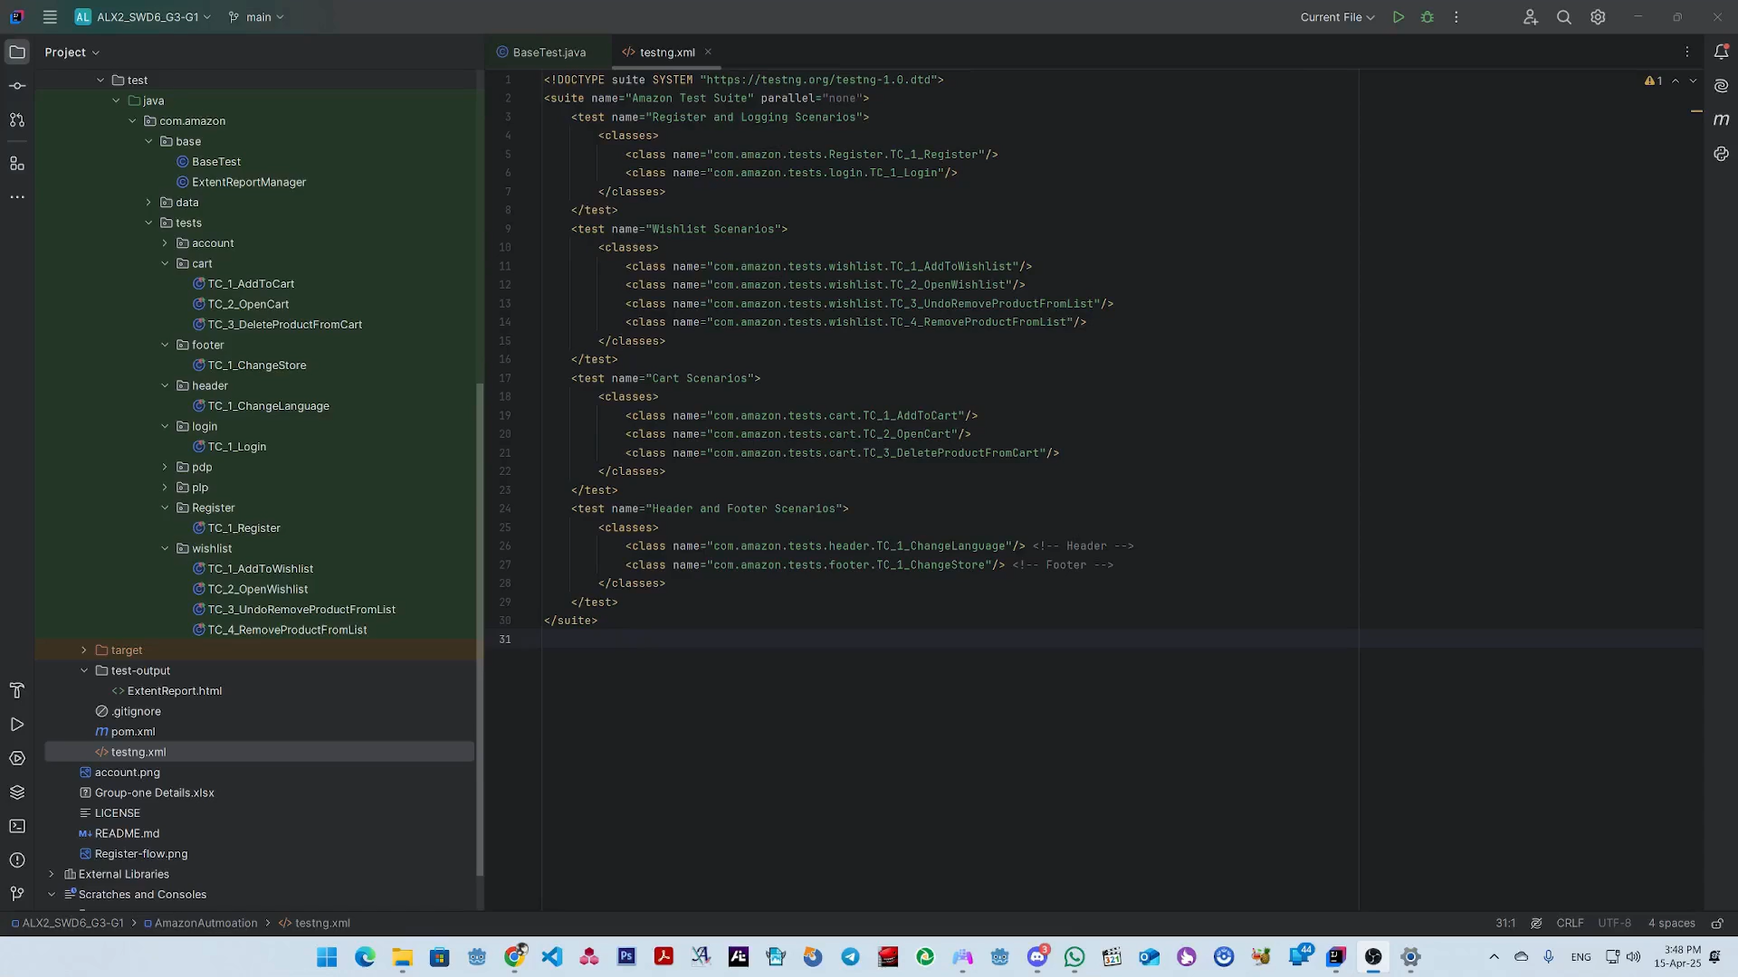
Register and Login Test Case Automation

Slide 16
MY ACCOUNT
USER STORY

Slide 17
Title | Description | Acceptance Criteria | Test Case ID
All Elements Clickable and Redirect Correctly | Ensure that all interactive elements on the homepage are clickable and navigate to the correct target URLs or sections. | ✓ All interactive elements (e.g., links, buttons, menus) on the homepage must be clickable. ✓ Each clickable element must redirect to the correct target URL or section. ✓ The navigation must occur without errors and in a reasonable time frame. ✓ After clicking a link, the user should land on the correct page or section. ✓ The test will pass if all links work as expected and redirect correctly. | TC_001_HomePage_AllElementsClickableAndRedirectCorrectly
Hover over Username Displays Account Submenu | Verify that when a registered user hovers over the "Username" element, a submenu appears with account-related options. | ✓ User is logged in and the "Username" element is visible. ✓ Hovering over the "Username" element should display a submenu or dropdown. ✓ The submenu should display options like "Your Account", "Your Orders", etc. ✓ All options in the submenu must be clickable and lead to the correct page. ✓ The submenu must appear without delay or errors on hover | TC_UI_002_Hover_Username_Submenu
Back to Top Button Functionality on Your Account Page | Verify that the "Back to Top" button on the "Your Account" page scrolls the page smoothly to the top. | ✓ User is logged in and on the "Your Account" page. ✓ The "Back to Top" button is visible and clickable. ✓ When clicked, the page should smoothly scroll back to the top. ✓The page should not jump or experience delays during scrolling. ✓ The button should function correctly regardless of how far down the page is scrolled. | TC_UI_003_BackToTop_AccountPage
View and Edit Browsing History Functionality | Verify that the user can view and edit their browsing history, including removing items and clearing or pausing history. | ✓ User is logged in and can access their browsing history. ✓ A list of recently viewed items should be displayed. ✓ The user can remove individual items from the history. ✓ The user can clear the entire history or pause the browsing history. ✓ All actions (removing items, clearing, pausing) should function correctly without errors. | TC_ACC_004_BrowsingHistory_ViewEdit

Slide 18
MY ACCOUNT
TEST CASES

Slide 19
Test Cases ID | Test Title | Pre Condition | Test Steps | Test Data | Expected Result | Actual Result | Status | Comments or Attachments
TC_001_HomePage_AllElementsClickableAndRedirectCorrectly | Test_All_Interactive_Elements_Work_and_Navigate | User already registered and logged in | 1- Open URL https://www.amazon.eg/. 2- Log in with valid account. 3- User is successfully logged in. 4- Click on account | Working Account | Each link navigates to the correct target URL or section. | Navigation worked as expected for each link. | Pass | -
TC_UI_002_Hover_Username_Submenu | Verify_Hover_Over_Username_Displays_Account_Submenu | User already registered and logged in | 1- Open URL https://www.amazon.eg/. 2- Log in with valid account. 3- User is successfully logged in. 4- Hover over account | Working Account | A submenu or dropdown appears displaying options such as:"Your Account" , "Your Orders" , etc | The submenu appeared on hover with all expected options visible and clickable. | Pass | -
TC_UI_003_BackToTop_AccountPage | Verify_Back_To_Top_Button_Functionality_on_Your_Account_Page | User already registered and logged in | 1- Open URL https://www.amazon.eg/. 2- Log in with valid account. 3- User is successfully logged in. 4- Click on account 5- Click on button back to top | Working Account | The page should smoothly scroll back to the top. | The "Back to Top" button successfully scrolls the page to the top as expected. | Pass | -
TC_ACC_004_BrowsingHistory_ViewEdit | Verify_View_And_Edit_Browsing_History_Functionality | User already registered and logged in | 1- Open URL https://www.amazon.eg/. 2- Log in with valid account. 3- User is successfully logged in. 4- Click on account 5-On the bottom on the page 6- appear my past items | Working Account | A list of recently viewed items should be displayed. | All options in the browsing history worked as expected; items were visible, removable, and the history could be cleared or paused. | Pass | -

Slide 20
HOMEPAGE
USER STORY

Slide 21
Title | Description | Acceptance Criteria | Test Case ID
Functionality of Main Promotional Banner | As a user, I want to interact with the main promotional banner with full functionality, so that I can easily access and explore highlighted offers on the website. | ✓ Both Carousel Arrow are clickable ✓ Clicking the right carousel make the banners advance sequentially ✓ Clicking the left carousel make the banners display in reverse order ✓ Each banner is clickable and redirects to its associated page | TC_Homepage_Main Promotional Banner_001 TC_Homepage_Main Promotional Banner_002 TC_Homepage_Main Promotional Banner_003
Click Category Cards for Product Navigation | As a user, I want to access each category card by clicking on its image or hyperlink, so that I can easily browse the related product list. | ✓ Each Category Card image should be clickable and redirect to associated page. ✓ Each Category Card hyperlink should be clickable and redirect to associated page . ✓ Clicking each Category Card hyperlink, category cart image must redirect to same associated page . | TC_Homepage_Catagory Cards_001 TC_Homepage_Catagory Cards_002 TC_Homepage_Catagory Cards_003
Validate functionality and navigation of homepage sliders | As a user, I want the homepage sliders to function smoothly and respond to interactions, so that I can easily view and access featured content, product cards, or category cards displayed in the sliders. | ✓ All slider hyperlinks must be functional and correctly redirect to their respective destination pages. ✓ Each Category Card hyperlink should be clickable and redirect to associated page . ✓ Both Carousel Arrow are clickable ✓ Clicking the right carousel make the products or categories cards advance sequentially ✓ Clicking the left carousel make the products or categories cards display in reverse order ✓Each card at the sliders clickable and redirect to associated page. ✓ "Start Over" button is clickable for Sliders that contain and resets the slider to the first item. ✓ All homepage sliders should have correct design and are fully responsive across viewports | TC_Homepage_Sliders_001 TC_Homepage_Sliders_002 TC_Homepage_Sliders_003 TC_Homepage_Sliders_004 TC_Homepage_Sliders_005 TC_Homepage_Sliders_006
Validate functionality of signing button or "start here" hyperlink | As user I want to access sign in or registration page easy from homepage so that icon access my account or create account. | ✓ Singing button is functional and redirect to signing page. ✓ Hyperlink "start here" is functional and should redirect to register page. | TC_Homepage_Signing and register Section_001 TC_Homepage_Signing and register Section_002

Slide 22
HOMEPAGE
TEST CASES

Slide 23
Test Cases ID | Test Title | Pre Condition | Test Steps | Test Data | Expected Result | Actual Result | Status | Comments or Attachments
TC_Homepage_Main Promotional Banner_001 | Right Carousel Arrow Functionality Check | - | 1- Open https://www.amazon.eg/ 2- Click on carousel Arrow (Right) of the Main Promotional Banner that at the middle top of the page 3- Repeat step 2 several times . | - | The carousel is fully functional. When the right navigation arrow is clicked, the promo banners advance sequentially and loop back to the first banner after reaching the end. | The carousel behaved as expected. Clicking the right side of the carousel advanced the promo banners in sequence and looped back to the first banner after the last one. | Pass | -
TC_Homepage_Main Promotional Banner_002 | Left Carousel Functionality Check | - | 1- Open https://www.amazon.eg/ 2- Click on carousel Arrow (left) of the Main Promotional Banner that at the middle top of the page 3- Repeat step 2 several times . | - | The carousel is fully functional When the left navigation arrow is clicked, the banners display in reverse order and cycle back from the beginning appropriately. | Clicking the left side of the carousel displayed the previous banners and cycled back in reverse correctly. | Pass | -
TC_Homepage_Main Promotional Banner_003 | Verify that each banner is clickable and redirects to its associated page | - | 1-Open https://www.amazon.eg/ 2-Click on the first banner in the carousel at the middle top of the page. 3-Click on the right arrow in the carousel to move to the next banner. 4-Repeat step 3 and click on each banner to test all available banners. 5-Ensure all banners are tested. | - | Each banner in the carousel is clickable and Clicking a banner redirects to the correct page. | Carousel navigation worked as expected and Clicking each banner successfully redirected to its associated landing page | Pass | -
TC_Homepage_Catagory Cards_001 | Verify that each Category Card image clickable and redirect to associated page. | - | 1-Open https://www.amazon.eg/ 2-Click on the image of the category card 3- repeat step 2 for each category card | - | Clicking the Category Card image redirects to the correct associated landing page. | Category Card image was clickable and redirected to the correct associated page successfully. | Pass | -
TC_Homepage_Catagory Cards_002 | Verify that each Category Card hyperlink clickable and redirect to associated page . | - | 1-Open https://www.amazon.eg/ 2-Click on the hyperlink of the category card 3- repeat step 2 for each category card | - | Clicking the Category Card hyperlink redirects to the correct associated landing page. | Category Card Hyperlink was clickable and redirected to the correct associated page successfully. | Pass | -
TC_Homepage_Catagory Cards_003 | Verify that when user click each Category Card hyperlink and category cart image redirect to same associated page . | - | 1-Open https://www.amazon.eg/ 2-Click on the hyperlink of the category card in new tap 3-Click on the image of the same category card 4- repeat step 2 and 3 for each category card | - | Clicking both the Category Card image and its associated hyperlink redirects the user to the same landing page. | Both the Category Card image and its hyperlink were clickable and redirected to the same associated landing page successfully. | Pass | -

Slide 24
Test Cases ID | Test Title | Pre Condition | Test Steps | Test Data | Expected Result | Actual Result | Status | Comments or Attachments
TC_Homepage_Sliders_001 | Checking that all slider hyperlinks (e.g., ‘See More’, ‘Shop Now’, ‘Start Shopping’, ‘Explore More’) are functional and correctly redirect to their respective destination pages. | - | 1-Open https://www.amazon.eg/ 2-Identify the clickable hyperlink (e.g., "Shop Now", "See More", etc.) on the currently visible slide. 3-Click on the hyperlink and verify that it redirects to the correct destination page. 4-Navigate back to the homepage. 5-Scroll down to the next slide. Repeat steps 2–3 for all slides in the homepage slider. | - | Each slider hyperlink should be clickable and must redirect the user to the intended destination page relevant to the slider content, without errors or blank pages. | All slider hyperlinks were clickable and successfully redirected to the correct destination pages. The content on each redirected page matched the slider’s promotional text . | Pass | -
TC_Homepage_Sliders_002 | Right Carousel Arrow Functionality Check | - | 1- Open https://www.amazon.eg/ 2- Scroll down to reach the first product slider 3- Click on carousel Arrow (Right) of the product slider 4- Repeat step 3 several times until reach the end of the displayed products 5- Scroll down . 6- repeat step 3 - 4 for each slider at the home page | - | The carousel is fully functional. When the right navigation arrow is clicked, the products cards advance sequentially, and carousel disappear when user reach the end of the products cards | The carousel behaved as expected. Clicking the right side of the carousel advanced the products cards in sequence and disappear when user reach the end of displayed products cards . | Pass | -
TC_Homepage_Sliders_003 | Left Carousel Arrow Functionality Check | - | 1- Open https://www.amazon.eg/ 2- Scroll down to reach the first product slider 3- Click on carousel Arrow (Right) of the product slider until reach the end of the displayed products 4- Click on carousel Arrow (left) of the product slider until reach the end of the displayed products 6- Scroll down . 7- repeat step 3 - 4 for each slider at the home page | - | The carousel is fully functional When the left navigation arrow is clicked, the products cards display in reverse order and cycle back from the beginning appropriately. | Clicking the left side of the carousel displayed the previous banners and cycled back in reverse correctly. | Pass | -
TC_Homepage_Sliders_004 | Verify that each card at the sliders clickable and redirect to associated page. | - | 1-Open https://www.amazon.eg/ 2-Scroll down until you reach the first horizontal product slider. 3-Click on each card/item in the first slider and verify that it redirects to the correct product or category page. 4-Return to the homepage and scroll to the next slider section. 5-Repeat step 3 for each card in all visible sliders on the homepage. | - | Clicking cards redirects to the correct associated landing page. | Cards were clickable and redirected to the correct associated page successfully. | Pass | -
TC_Homepage_Sliders_005 | Verify that all homepage sliders have correct design and are fully responsive across viewports | Use browser that support developer tool ex : Google chrome | 1-Open the homepage in a modern browser (e.g., Chrome). 2-Press F12 to open Developer Tools. 3-Enable device toolbar (toggle device emulation). 4-Select a range of common device viewports (e.g., iPhone 14, iPad, Galaxy S20, desktop). 5-Scroll through each slider (product and category sliders) in each viewport. 6-Observe the layout, alignment, and responsiveness of each card within the sliders. 7-Resize the viewport manually (drag corners) to test for adaptive behavior. 8-Check for consistency in card height, spacing, and alignment across all viewports. | - | All sliders should adapt correctly to different screen sizes. Cards inside sliders should remain visually consistent equal height, proper alignment, and no overflow or layout issues. | The last slider on the homepage shows uneven card height. One or more cards do not maintain consistent height, causing a broken or misaligned layout on both desktop and mobile view. | Fail | Attachment
TC_Homepage_Last Slider_006 | Verify that the "Start Over" button is clickable and resets the slider to the first item | - | 1- Open https://www.amazon.eg/ 2- Scroll down to reach last slider "Customers who viewed items in your browsing history also viewed" in the page 3- Click on the right Carousel 3 times 4- Click on "Start over" | - | When the "Start Over" button is clicked, the slider should scroll or jump back to display the first item in the sequence. The button should be responsive and perform this action without errors. | The "Start Over" button was clickable and successfully returned the slider to the first item as expected. The functionality worked correctly and without delay. | Pass | -

Slide 25
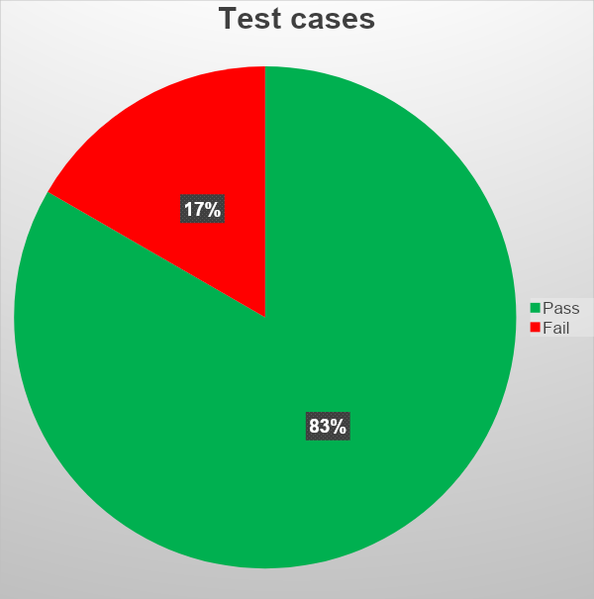
TEST CASE RESULTS HOMEPAGE: SLIDERS
10%
Out of 12 test cases related to homepage we found 1 bug.
90 %

Slide 26
HOMEPAGE
PRODUCT - DETAILS
USER STORY

Slide 27
Title | Description | Acceptance Criteria | Test Case ID
Product information with user friendly interface | As a user , I want to view a product’s title, price, description state of the product (in stock or out of stock), and brand so that I can understand what the item is. | ✓user clicked on any product each of product should have title, description, product availability , product image gallery , sizes or color (for clothes) add to cart button and brand should be displayed at PDP | TC_ProductDetails_ProductInfo_001
Category Card image clickable, and redirect to associated page | As a user, i want to verify that each category card image is clickable and redirects to the associated page, so that i can display specific product details easily. | ✓Each category card is displayed with a relevant image on the homepage. ✓The image within each card is clickable. ✓When the user clicks on a category card image, he is redirected to the correct category page. ✓The redirected page displays products related to the selected category. ✓There is no error upon clicking any image. ✓The category card images and links work correctly across various devices and screen sizes. | TC_ProductDetails_ProductImages_001 TC_ProductDetails_ProductImages_002
The cart button works and responds differently depending on the scenario. | As a user , I want to view a confirmation message when a product is successfully added to the cart, Or an alert message if the product is out of stock and cannot be added, So that I receive immediate feedback on my action when I click “Add to Cart” on the product details page. | ✓Add to cart is displayed for each products details page of any product . ✓Add to cart clickable and react with different scenarios . ✓When the user clicks on add to cart button at any PDP of any available product should view a confirmation message the product added successfully to the cart ✓When the user clicks on add to cart button at any PDP of any not available product should view a alert message the product cannot add to the cart | TC_ProductDetails_Addtocart_001 TC_ProductDetails_Addtocart_002

Slide 28
HOMEPAGE
PRODUCT - DETAILS
TEST CASES

Slide 29
Philip
Test Cases ID | Test Title | Pre Condition | Test Steps | Test Data | Expected Result | Actual Result | Status | Comments or Attachments
TC_Homepage_Signing and register Section_001 | Checking if signing button is functional and redirect to signing page | - | 1- Open https://www.amazon.eg/ 2- Scroll down at the end of the page 3- Click on sign in button that displayed in middle of the page | - | Clicking on sign in button should redirect the user to a signin page | The button is functional, and work as expected | Pass | -
TC_Homepage_Signing and register Section_002 | Checking if hyperlink "start here" is functional and redirect to register page | - | 1- Open https://www.amazon.eg/ 2- Scroll down at the end of the page 3- Click on the hyperlink "start here" that displayed in middle of the page | - | Clicking on the hyperlink should redirect the user to a Registration page | The button is functional, and work as expected | Pass | -
TC_ProductDetails_ProductInfo_001 | Checking if product’s title, description, product availability , product image gallery , sizes or color (for clothes) ,Add to cart button and brand are displayed at PDP | - | 1-Open https://www.amazon.eg/ 2-Scroll down till you reach “Deals below 250 EGP” slider 3-Click on the first product from the right 4-Ensure everything is displayed with a user-friendly interface 5-Click the homepage logo to return to the homepage 6-Repeat steps 2 and 3, but this time click the last product on the slider → again validate UI | - | when user clicked on any product each of product’s title, description, product availability , product image gallery , sizes or color (for clothes) add to cart button and brand should be displayed at PDP | As expected, | Pass | -
TC_ProductDetails_ProductImages_001 | verify that hover on any image that displayed in gallery sidebar should change the main product image | TC_ProductDetails_ProductInfo_001 (Passed) product gallery is displayed | 1-Open https://www.amazon.eg/ 2-Scroll down till you reach “Deals below 250 EGP” slider 3-Click on any product card 4- hover on all the small images that located at the left top of the page | - | The main image of the product immediately change to the image you just hover in it | As expected, | Pass | -
TC_ProductDetails_ProductImages_002 | checking if user hover the main product image of any product should trigger product Image magnifier feature | TC_ProductDetails_ProductInfo_001 (Passed) product gallery is displayed | 1-Open https://www.amazon.eg/ 2-Click on "Electronics" button at the navbar to open product list of that category 3-Click on any product card 4- Hover on the main image at the top left of the page 5-Click the homepage logo to return to the homepage 6- Repeat step 2 (but a different category ), 3 ,4 | - | when user hover the main product image of any product should trigger product Image magnifier feature | all products in all category behave as expected except "Fashion category " at Shoes and clothes section | Fail | Attachment
TC_ProductDetails_AddToCart_001 | Checking if add to cart button is functional and a message appear and confirm that product added to the cart successfully when user click on it | TC_ProductDetails_ProductInfo_001 (Passed) Add to cart button displayed is displayed | 1-Open https://www.amazon.eg/ 2-Scroll down till you reach “Deals below 250 EGP” slider 3-Click on the first product from the right for example 4- Click on the add to cart button at left of the page | - | A confirm message should appears confirm that the product added successfully to the cart . | As expected, | Pass | -
TC_ProductDetails_AddToCart_002 | Verify that the user cannot increase the quantity of a product beyond the available stock (only 1 item available). | TC_ProductDetails_ProductInfo_001 (Passed) Add to cart button displayed is displayed | 1-Open https://www.amazon.eg/ 2-Search for Elmaayergy S-1202 Mirror 3-Click on the first product from the left of the page 4- Click add to cart 5- Click on the + button to increase quantity | - | unable to increase a quantity of that product and a message appear " Sorry, there was a problem We're sorry. You've requested more of Elmaayergy | As expected, | Pass | -

Slide 30
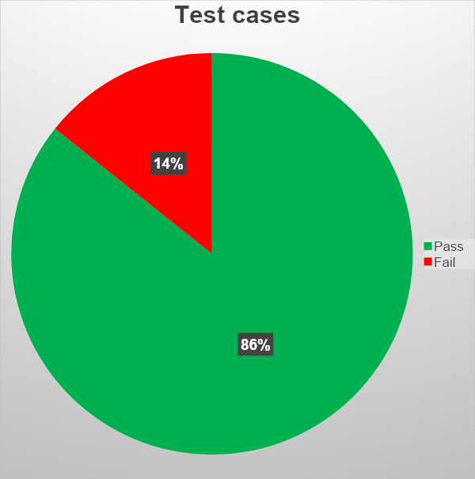
TEST CASE RESULTS HOMEPAGE: Signing-register & Product details
10%
Out of 7 test cases related to homepage we found 1 bug.
90%

Slide 31
CART
USER STORY

Slide 32
Title | Description | Acceptance Criteria | Test Case ID
As an Authenticated/visitor user I want to manage my cart | The user can manage his selected products | ✓ As an (Authenticated user/site visitor), I can see my Selected products ✓ As an (Authenticated user/site visitor), I can delete any product ✓ As an (Authenticated user/site visitor), I can modify quantity ✓ As an (Authenticated user/site visitor), I can click on "Save for Later" link ✓ As an (Authenticated user/site visitor), I can share my selected product by link ✓ As an (Authenticated user/site visitor), I can proceed to checkout | cart-001 cart-002 cart-003 cart-004 cart-005 cart-006

Slide 33
CART
TEST CASES

Slide 34
Test Cases ID | Test Title | Pre Condition | Test Steps | Test Data | Expected Result | Actual Result | Status | Comments or Attachments
cart-001 | The user can see his selected product | Selected products | 1- Open URL https://www.amazon.eg/ 2- At the search bar, Search for "Socks" 3- At the first product appeared after Result, Click on "Add to cart" 4- At the right-hand side, Click on "Go to Basket" | - | The Chosen product is displayed in the shopping cart page | Works as expected | Pass | -
cart-002 | The user can increase/decrease the quantity of a certain product | Selected products | 1- Open URL https://www.amazon.eg/ 2- At the search bar, Search for "Socks" 3- At the first product appeared after Result, Click on "Add to cart" 4- At the right-hand side, Click on "Go to Basket" 5- Click on (+/-) of a product | - | The quantity of that modified product should increase and decrease | Works as expected | Pass | -
cart-003 | The user can delete a certain product | Selected products | 1- Open URL https://www.amazon.eg/ 2- At the search bar, Search for "Socks" 3- At the first product appeared after Result, Click on "Add to cart" 4- At the right-hand side, Click on "Go to Basket" 5- Click on "Delete" in a product | - | The product deleted from the shopping cart | Works as expected | Pass | -

Slide 35
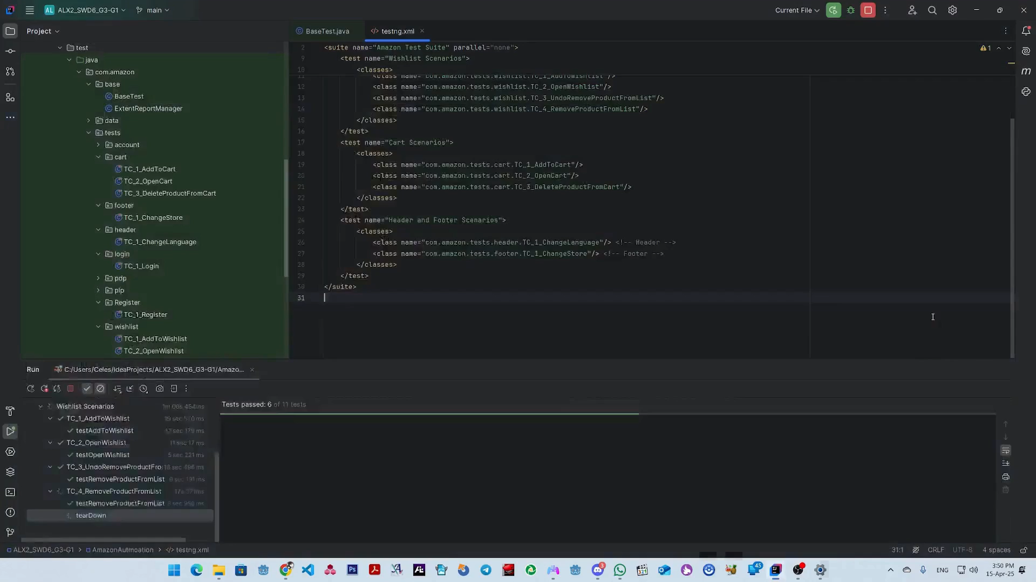
Cart Test Cases Automation

Slide 36
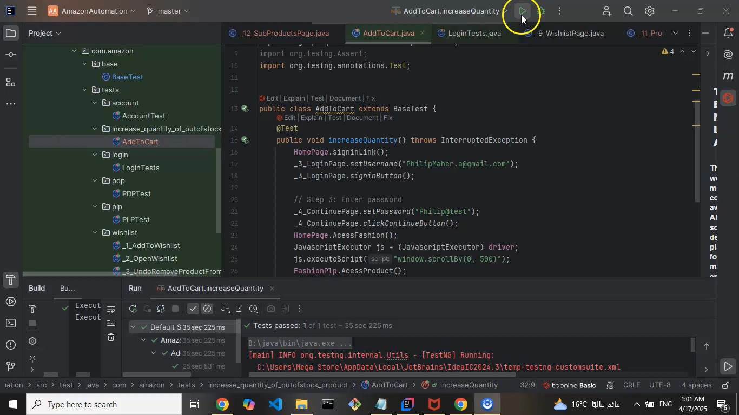
Cart (Negative) Test Case Automation

Slide 37
WISH LIST FUNCTIONALITY
USER STORY

Slide 38
Title | Description | Acceptance Criteria | Test Case ID
Add item to default Wish List | As a logged-in user, I want to add an item to my default wish list, so I can save it for later | ✓ Item is added to the default wish list ✓ A confirmation message is shown ✓ No error is thrown during the process | TC-WL-001
Add item to custom Wish List | As a logged-in user with custom lists, I want to add an item to a specific custom list to organize my saved items | ✓ "Add to List" dropdown shows available lists ✓ Selected list receives the item ✓ Confirmation message is shown | TC-WL-002
Add out-of-stock item to Wish List | As a logged-in user, I want to add out-of-stock items to my wish list to get notified when they're available | ✓ Out-of-stock items can be added to lists ✓ Item is saved correctly ✓ Notification behavior is documented | TC-WL-003
Prevent duplicate entries | As a user, I want the system to detect or manage duplicates in my list to avoid confusion | ✓ System prevents duplicate items OR allows with a message ✓ Confirmation includes handling of duplicates | TC-WL-004
Restrict add-to-list for guests | As a guest user, I should not be able to add items to wish lists unless I log in | ✓ "Add to List" prompts login ✓ No item added unless logged in | TC-WL-005
View added items in All elements in the header section are visible and clickable. page | As a user, I want to confirm that items I added are visible in the wish list page for tracking | ✓ Newly added item appears under selected wish list ✓ Correct title, image, and price shown | TC-WL-006
Remove single item from wish list | As a logged-in user, I want to remove an individual item from my wish list so I can manage saved products | ✓ "Delete/Remove" button is visible on each item ✓ Clicking it removes the item immediately ✓ Confirmation or undo message appears (optional) | TC-WL-007
Remove item via product page | As a user, I want to remove an item from the wish list directly from the product page if it's already saved | ✓ "Add to List" toggle changes to "Remove from List" if already added ✓ Clicking removes the item from the selected list ✓ Message confirms item is removed | TC-WL-008
Undo remove action | As a user, I want to undo accidental item removal from a wish list to recover from mistakes | ✓ Undo option appears briefly after removal ✓ Clicking undo restores the item to the list | TC-WL-009

Slide 39
WISH LIST
TEST CASES

Slide 40
Test Cases ID | Test Title | Pre Condition | Test Steps | Test Data | Expected Result | Actual Result | Status | Comments or Attachments
Add item to default Wish List | User is logged in | 1. Open https://www.amazon.eg/ 2. Search for an item 3. Click on it 4. Click "Add to List" | Any in-stock product | Product is added to the default wish list, confirmation message appears | As expected, | Desktop: Windows 11 Chrome | Pass | -
Add item to custom Wish List | User is logged in and has at least one custom wish list | 1. Open https://www.amazon.eg/ 2. Open product page 3. Click "Add to List" dropdown 4. Choose custom list | Custom list "Tech" | Product added to the selected list, confirmation appears | As expected, | Desktop: Windows 11 Chrome | Pass | -
Add out-of-stock item to Wish List | User is logged in | 1. Open https://www.amazon.eg/ 2. Open out-of-stock product page 3. Click "Add to List" | Any out-of-stock product | Product is still added to wish list (for notification when available) | As expected, | Desktop: Windows 11 Chrome | Pass | -
Verify duplicate entry handling | Item already in list | 1. Open https://www.amazon.eg/ 2. Go to product page 3. Click "Add to List" again | Previously added item | Confirmation should indicate item is already in the list or allow duplicate | As expected, | Desktop: Windows 11 Chrome | Pass | -

Slide 41
Khalil
Test Cases ID | Test Title | Pre Condition | Test Steps | Test Data | Expected Result | Actual Result | Status | Comments or Attachments
Add item without login | User is not logged in | 1. Open https://www.amazon.eg/ 2. Open product page 3. Click "Add to List" | Any item | User is redirected to login page | As expected, | Desktop: Windows 11 Chrome | Pass | -
Verify added item appears in Wishlist page | Item added to list | 1. Open https://www.amazon.eg/ 2. Go to Accounts > Your Lists 3. Open relevant list | N/A | Added item should be visible in the selected list | As expected, | Desktop: Windows 11 Chrome | Pass | -
Remove single item from wish list | User is logged in and has at least one item in wish list | 1. Go to “Accounts & Lists” 2. Open “Your Lists” 3. Locate item 4. Click “Remove” or “Delete” | Any item previously added | Item is removed from list Confirmation appears List is updated instantly | As expected, | Desktop: Windows 11 Chrome | Pass | -
Remove item from product page | Item is in wishlist, user is logged in | 1. Open product page 2. Confirm item is already in wish list 3. Click on the “♥” or “Added to List” icon 4. Select “Remove from list” | Product already in a wish list | Item is removed Message confirms removal Icon state is updated | There is no “♥” button available and no way to remove the product from wishlist from the PDP | Desktop: Windows 11 Chrome | Fail | Attachment
Undo remove action | Undo functionality is supported by UI | 1. Open https://www.amazon.eg/ 2. Remove an item from wish list 3. Click “Undo” | Any item in list | Item is restored to original position in the list No duplication | As expected, | Desktop: Windows 11 Chrome | Pass | -

Slide 42
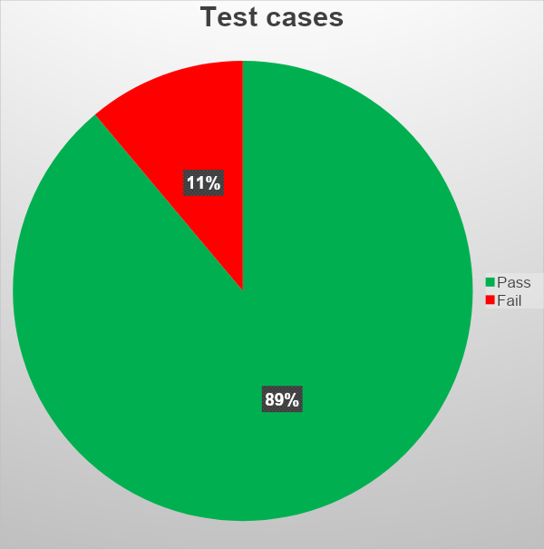
TEST CASE RESULTS FEATURE WISHLIST FUNCTIONALITY
Out of 9 test cases related to wishlist we found 1 bug.

Slide 43
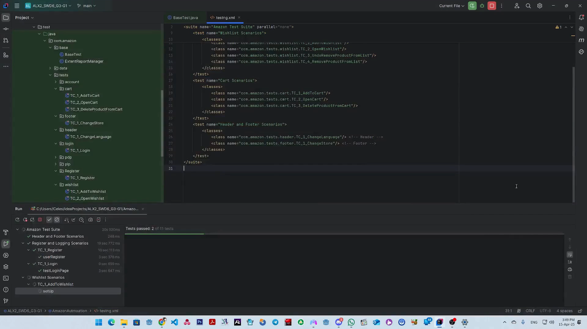
Wish List Test Cases Automation

Slide 44
MY ACCOUNT – VERIFICATION AND CHECKOUT SECURITY FEATURE REVIEW
USER STORY

Slide 45
Title | Description | Acceptance Criteria | Test Case ID
Reauthentication Prompt During Purchase Process | Verify that a reauthentication prompt is triggered during the checkout process to ensure secure transactions. | ✓ User is logged in and proceeds to the checkout page. ✓ If prompted, the user must enter their credentials again for reauthentication. ✓ Upon successful reauthentication, the user can continue with the purchase. ✓ If credentials are entered correctly, the transaction should proceed without issues. ✓ If authentication fails, the user should be notified and unable to complete the purchase. | TC_SEC_005_Reauthentication_OnCheckout
Phone Number Request When Not Added During Authentication | Verify that the system prompts for a phone number and sends an OTP for verification when no phone number is associated with the user account during the authentication process. | ✓ User is logged in and selects an item to buy. ✓ The system detects that no phone number has been added to the account. ✓ A prompt appears requesting the user to enter a phone number. ✓ After entering the phone number, the system sends an OTP (One-Time Password) to verify it. ✓ Once verified, the user is able to securely continue with the purchase process. | TC_SEC_006_PhoneNumber_Prompt_On_Auth
Correct OTP Allows Progression to Next Step | Verify that the system accepts a correct and valid OTP for verification, allowing the user to proceed to the next step in the purchase process. | ✓ User is logged in, selects an item to buy, and has added a phone number. ✓ The system sends an OTP to the entered phone number. ✓ The user enters the OTP. ✓ The system verifies the OTP and checks that it is correct and not expired. ✓ If the OTP is correct, the user should be allowed to proceed to the next step of the purchase process without error. | TC_SEC_007_OTP_Correct_Proceed

Slide 46
MY ACCOUNT-SECURE CHECKOUT & AUTHENTICATION FEATURE TESTING
TEST CASES

Slide 47
Test Cases ID | Test Title | Pre Condition | Test Steps | Test Data | Expected Result | Actual Result | Status | Comments or Attachments
TC_SEC_005_Reauthentication_OnCheckout | Verify_Reauthentication_Prompt_During_Purchase_Process | User already registered and logged in For first time | 1- Open URL https://www.amazon.eg/. 2- Log in with valid account. 3- User is successfully logged in. 4- Choosing any item 5- click on Buy now | Working account For first time user account experience | Upon successful re-authentication, the user can proceed with the purchase. | Reauthentication prompt appeared as expected. User was able to re-enter credentials and complete the transaction securely. | Pass | First time user experience
TC_SEC_006_PhoneNumber_Prompt_On_Auth | Verify_Phone_Number_Request_When_Not_Added_During_Authentication | User already registered and logged in selected item to buy No phone number was added | 1- Open URL https://www.amazon.eg/. 2- Log in with valid account. 3- User is successfully logged in. 4- Choosing any item 5- click on Buy now 6- add the phone number | Working account For first time user account experience add working phone number | Once verified, the user should be able to continue securely. | The system successfully prompted for a phone number, sent an OTP for verification, and allowed secure continuation of the process. | Pass | First time user experience
TC_SEC_007_OTP_Correct_Proceed | Verify_Correct_OTP_Allows_Progression_To_Next_Step | User already registered and logged in selected item to buy added phone number | 1- Open URL https://www.amazon.eg/. 2- Log in with valid account. 3- User is successfully logged in. 4- Choosing any item 5- click on Buy now 6- add the phone number 7- add the OTP code | Working account For first time user account experience add working phone number receive OTP message | The system should accept the OTP if it is correct and not expired. | user was successfully verified and taken to the next step in the process without error. | Pass | First time user experience

Slide 48
MY ACCOUNT – Transaction Path Testing: From Cart to Confirmation
USER STORY

Slide 49
Title | Description | Acceptance Criteria | Test Case ID
Add New Shipping Address During Checkout | Verify that the user can add a new shipping address during the checkout process. | ✓ User is logged in and has selected an item to buy. ✓ During the checkout process, the user is given the option to add a new shipping address. ✓ The user should be able to enter a valid address in all required fields (e.g., street, city, state, postal code, country). ✓ The system should accept the input and validate the address format. ✓ Once entered, the new shipping address should be successfully added and selected for the order. | TC_CHK_08_AddNewShippingAddress
Choose Payment Method During Checkout | Verify that the user can select a payment method during the checkout process, and if a new card is added, it is securely validated. | ✓ User is logged in, has selected an item to buy, and has selected a shipping address. ✓ During checkout, the user is presented with the option to choose a payment method. ✓ If the user adds a new card, the system should validate the card details (e.g., card number, expiration date, CVV). ✓The new payment method should be securely added to the account. ✓ The user should be able to successfully select the payment method and proceed to the next step of the checkout process without errors. | TC_CHK_09_SelectPaymentMethod
Apply Offers, Gift Cards, and Promo Codes During Checkout | Verify that the user can apply valid promo codes, gift cards, or offers during checkout, and the order total is updated accordingly. | ✓ User is logged in, has selected an item to buy, selected a shipping address, and chosen a payment method. ✓ The user enters a valid promo code or gift card during checkout. ✓ If the promo code/gift card is valid, the order total should be updated to reflect the discount. ✓ If the promo code/gift card is invalid, no discount should be applied, and an error message should be displayed. ✓ If the promo code/gift card is valid, the discount is applied successfully, and the user is able to proceed to the next step. | TC_CHK_010_ApplyOffersAndPromos
Review Items and Shipping Details on Final Review Page | erify that the final review page displays all selected items, their quantities, prices, and shipping details accurately. | ✓ User is logged in, has selected an item to buy, chosen a shipping address, selected a payment method, and applied any offers. ✓ On the final review page, all items should be listed with correct quantities, prices, and applicable offers. ✓ Shipping details, including the address and shipping method, should be displayed accurately. ✓ The user should have the option to edit items, quantities, or shipping details if needed. ✓ The user should be able to review all information and proceed to place the order without any issues. | TC_CHK_011_ReviewItemsAndShipping
Order Summary Calculation and Display | Verify that the order summary correctly calculates and displays the final amount, including any applied promotions or discounts. | ✓ User is logged in and has selected an item to buy. ✓ The order summary should display the correct breakdown, including item prices, discounts, taxes, and shipping costs. ✓ The final order total should be accurate and reflect any applied promotions or discounts. ✓ All fields in the order summary should be clearly displayed, with no errors in calculation. ✓ The final amount shown should match the expected total based on the selected items, promotions, and shipping costs. | TC_CHK_012_OrderSummary_Verification

Slide 50
USER PURCHASE JOURNEY
TEST CASES

Slide 51
Test Cases ID | Test Title | Pre Condition | Test Steps | Test Data | Expected Result | Actual Result | Status | Comments or Attachments
TC_CHK_08_AddNewShippingAddress | Verify_Add_New_Shipping_Address_During_Checkout | User already registered and logged in selected item to buy | 1- Open URL https://www.amazon.eg/. 2- Log in with valid account. 3- User is successfully logged in. 4- Choosing any item 5- click on Buy now 6- Fill address (for first time user) | Working account Select correct address | The address form should accept valid input in all required fields. | The new shipping address was added and selected successfully for the order. | Pass | -
TC_CHK_09_SelectPaymentMethod | Verify_Choose_Payment_Method_During_Checkout | User already registered and logged in selected item to buy selected the address for shipping | 1- Open URL https://www.amazon.eg/. 2- Log in with valid account. 3- User is successfully logged in. 4- Choosing any item 5- click on Buy now 6- After selecting the address 7- Fill the payment method | Working account Select correct address Select working payment methoud | If a new card is added, it should be validated and added to the account securely. | Payment method was selected successfully; user was able to proceed to the next step of checkout. | Pass | -
TC_CHK_010_ApplyOffersAndPromos | Verify_Apply_Offers_GiftCards_And_PromoCodes_During_Checkout | User already registered and logged in selected item to buy selected the address for shipping selected payment method | 1- Open URL https://www.amazon.eg/. 2- Log in with valid account. 3- User is successfully logged in. 4- Choosing any item 5- click on Buy now 6- After selecting the address 7- Fill the payment method 8- Check apply offers and promos | Working account Select correct address Select working payment methoud Appear only if it avaiable | If the promo code/gift card is valid or Invalid -The order total should be updated to reflect the discount. -Valid promo code was accepted, discount applied successfully, and user was able to proceed. | Valid promo code was accepted, discount applied successfully, and user was able to proceed if not the promo will not be aplied | Pass | --
TC_CHK_011_ReviewItemsAndShipping | Verify_Items_And_Shipping_Details_On_Final_Review_Page | User already registered and logged in selected item to buy selected the address for shipping selected payment method selected offers | 1- Open URL https://www.amazon.eg/. 2- Log in with valid account. 3- User is successfully logged in. 4- Choosing any item 5- click on Buy now 6- After selecting the address 7- Fill the payment methoud 8-Review tiems and shipping | Working account Select correct address Select working payment method Select payment method | All items should be correctly listed with accurate quantities, prices, and shipping details. | Items and shipping details were correctly displayed and editable. User was able to review and proceed to place the order | Pass | -
TC_CHK_012_OrderSummary_Verification | Verify_Order_Summary_Calculation_And_Display | User already registered and logged in selected item to buy | 1- Open URL https://www.amazon.eg/. 2- Log in with valid account. 3- User is successfully logged in. 4- Choosing any item 5- click on Buy now | Working account Items selected | Final amount shown as Order total should be accurate | All fields in the Order Summary are correctly calculated and clearly displayed. Final total is accurate and reflects applied promotion. | Pass | -

Slide 52
TEST CASE RESULTS FEATURE MY ACCOUNT & VERIFICATION FUNCTIONALITY
Out of 12 test cases related to my account verification we found 0 bug.

Slide 53
HEADER OF AMAZON WEBSITE
USER STORY

Slide 54
Title | Description | Acceptance Criteria | Test Case ID
Verify visibility of header elements | As a user, i want to verify the visibility of the header elements on the Amazon website, so that i can easily access key navigation and account options. | ✓The header is visible at the top of the Amazon homepage. ✓The header contains all essential elements like : Amazon logo, Search bar, Language switcher, Account & Lists dropdown, etc. ✓All elements are clearly displayed and not hidden or cut off. ✓The header is responsive and displays correctly on various screen sizes. ✓No overlapping or broken layout issues are present in the header section. | TC_Header_001
Test Amazon logo redirect | As a user, i want to test the Amazon logo redirect, so that i can return to the homepage from any page on the website. | ✓The Amazon logo is visible in the header section on all pages of the website. ✓The logo is clickable and displayed as a navigation link. ✓When the user clicks on the logo, he is redirected to the Amazon homepage. ✓The redirection happens without any error or delay. ✓The logo maintains the same functionality across different devices. | TC_Header_002
Test language switcher | As a user, i want to test the language switcher on the Amazon website, so that i can view the site content in my preferred language. | ✓The language switcher is visible on the homepage in header section. ✓The switcher displays the currently selected language such as : Arabic. ✓Amazon language switcher is clickable. ✓Clicking on the language switcher shows a list of available languages. ✓The user can select a different language from the list. ✓After selecting a new language, the page reloads with content in the selected language. | TC_Header_003

Slide 55
AMAZON WEBSITE HEADER FUNCTIONALITY
TEST CASES

Slide 56
Test Cases ID | Test Title | Pre Condition | Test Steps | Test Data | Expected Result | Actual Result | Status | Comments or Attachments
TC-Header-001 | Verify visibility of header elements | User is on Amazon homepage | 1. Open Amazon homepage 2. Observe the header area | N/A | Header includes Amazon logo, search bar, country selector, language selector, account/sign-in, orders, cart, and Prime links | As expected, | Pass | -
TC-Header-002 | Test Amazon logo redirect | Any page on Amazon | 1.Open any page 2.Click on Amazon logo in header | Any page (e.g., product page) | User is redirected to homepage | As expected, | Pass | -
TC-Header-003 | Test language switcher | Language selector is visible | 1. Open Amazon homepage 2. Click on language selector (e.g., “EN”) 3. Select another language | Switch to Arabic | UI updates to selected language | As expected, | Pass | -

Slide 57
AMAZON WEBSITE FOOTER FUNCTIONALITY
USER STORY

Slide 58
Title | Description | Acceptance Criteria | Test Case ID
Verify visibility of footer sections | As a user, i want to verify the visibility of the footer sections on the Amazon website, so that i can ensure all footer content is displayed properly. | ✓The footer section is displayed at the bottom of the homepage. ✓The footer contains multiple clearly labeled sections (such as : Get to Know Us, Make Money with Us, Let Us Help You, etc). ✓Each section in the footer contains a list of relevant links. ✓All footer links are visible without requiring user interaction. | TC_Footer_001
Verify “Back to Top” button | As a user, i want to verify the “Back to Top” button on the Amazon website, so that i can quickly return to the top of the page after scrolling down. | ✓The user can scroll down the Amazon homepage. ✓The "Back to Top" button appears at the bottom of the page when the user scrolls down. ✓The "Back to Top" button is clearly visible and labeled appropriately. ✓When the user clicks the "Back to Top" button, the page scrolls smoothly back to the top. ✓The button is functional across major pages such as the homepage, product listings, and product detail pages. ✓The button remains in a consistent location on the page. | TC_Footer_002
Verify country redirect button | As a user, i want to verify the country redirect button on the Amazon website, so that i can change my regional preferences and view localized content. | ✓The country redirect button is displayed in the footer or header section of the Amazon website. ✓The button shows the current selected country or region such as : "United States", "Egypt", etc. ✓When the user clicks the country redirect button, a modal or page with country/region options appears. ✓The list includes multiple country/region choices with corresponding language and currency settings. ✓The user can select a different country/region from the list. ✓After selection, the website updates to reflect the new region. | TC_Footer_003

Slide 59
AMAZON WEBSITE FOOTER FUNCTIONALITY
TEST CASES

Slide 60
Abdo
Test Cases ID | Test Title | Pre Condition | Test Steps | Test Data | Expected Result | Actual Result | Status | Comments or Attachments
TC-Footer-001 | Verify visibility of footer sections | User is on any page (e.g., homepage) | 1.Open any page 2. Scroll to bottom of the page 3. Observe footer area | N/A | Footer contains sections like “Get to Know Us,” “Make Money with Us,” “Let Us Help You,” language/currency switcher, and country list | As expected, | Pass | -
TC-Fooder-002 | Verify “Back to Top” button | User has scrolled down enough to see the footer | 1.Open any page 2.Click “Back to Top” button at footer | N/A | Page scrolls smoothly to the top | As expected, | Pass | -
TC-Footer-003 | Verify country redirect button | Country/region list is visible in footer | 1.Open any page 2.Click on a country (e.g., Egypt) | Select Canada | User is redirected to the selected Amazon country site when clicking on " go to website " button | As expected, | Pass | -

Slide 61
TEST CASE RESULTS FEATURE HEADER & FOOTER OF AMAZON WEBSITE
Out of 6 test cases related to my account verification we found 0 bug.

Slide 62
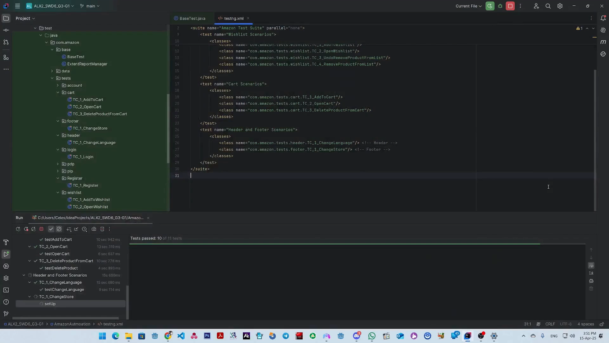
Header and Footer Test Case Automation

Slide 63
BUG REPORT
of Amazon.com

Slide 64
Bug ID | Bug Title | TC ID | Description | Expected Result | Actual Result | Severity | Priority | Attachments& Comments
bug_register_001 | incorrect Egyptian number doesn't lead to red rectangle around the number field | register-006 | While trying to register, the input of phone number can accept random wrong structure | Expected to see a red rectangle around phone field | No Error and success proceeding | Critical | High | -
bug_register_002 | Numbers in the Name field doesn't lead to red rectangle around the the field | register-007 | UnExpected behavior of a Name field that the user can name himself by numbers | Expected to see a red rectangle around Name field | No Error and success proceeding | low | low | -
bug_register_003 | The user can make weak password | register-008 | Weak Password that has only numbers and more than 6 characters doesn't generate any errors | Expected to see a red rectangle around Password field | No Error and success proceeding | Critical | High | -
HP_BUG_001 | The last slider on the homepage shows uneven card height | TC_Homepage_Sliders_005 | Some cards have inconsistent heights, with a few appearing taller than the rest. | All sliders should adapt correctly to different screen sizes. Cards inside sliders should remain visually consistent equal height, proper alignment, and no overflow or layout issues. | The last slider on the homepage shows uneven card height. One or more cards do not maintain consistent height, causing a broken or misaligned layout on both desktop and mobile view. | Low | Low | Attachment
PDP_BUG__001 | Clicking on any image at galley of any product at fashion category shoes or clothes section not functional | TC_ProductDetails_ProductImages_002 | all products in all category behave as expected except "Fashion category " at Shoes and clothes section | Clicking on any product image at images gallery of any product should change the main product image to that image which user clicked and hover the main product image of any product should trigger product Image magnifier feature | Clicking on any image not functional (nothing happened) and when user hover the main image of the product nothing happen either | Medium | Low | Attachment
WL_BUG_001 | Missing “♥” (Wishlist) button on Product Detail Page (PDP) – Unable to remove item from Wishlist | TC-WL-008 | Users cannot manage Wishlist items directly from the product page, leading to a poor user experience and inconsistent behavior compared to search/listing pages. | The “♥” (heart) icon or “Added to List” dropdown should be visible. Clicking it should allow the user to remove the product from their wish list. Icon state should update to reflect removal. | There is no “♥” button or any visual control on the Product Detail Page to remove the item from the Wishlist. No alternative option is present on the PDP to manage the Wishlist status of the item. | Medium | Medium | Attachment

Slide 65
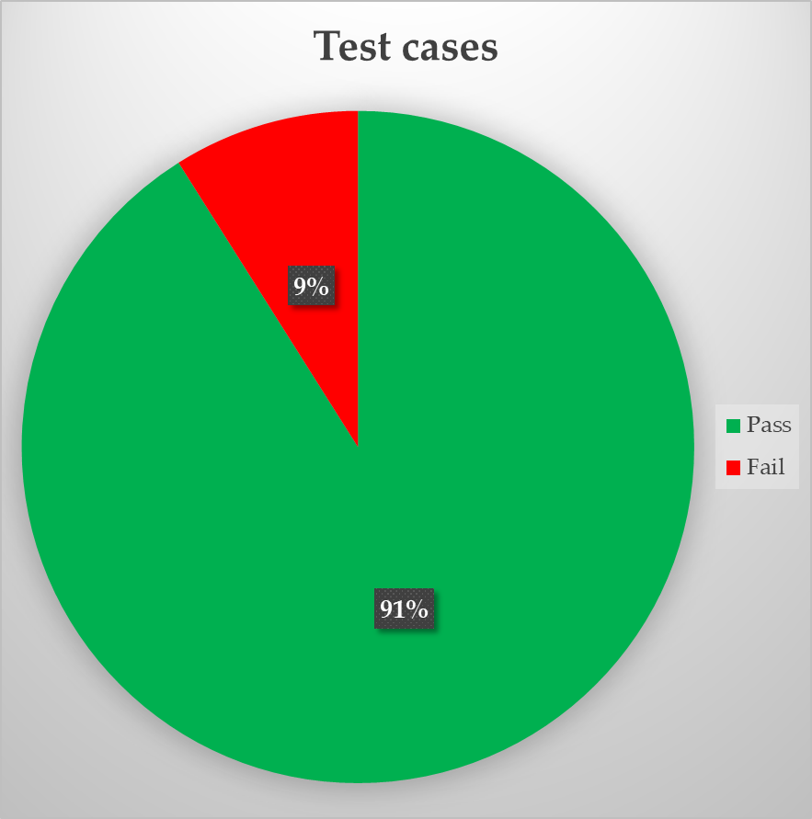
CONCLUSION FROM BUG REPORT
We created 67 test cases on 8 Features : we found 61 Passed cases and 6 Failed cases.

Slide 66

WE COVERED:
NEXT:
Manual testing
Registration/Login
My Account
Home page
Product List Page
Product Details Page
Wishlist
View Cart
Checkout
Header/Footer
API Testing
Postman
Automation
Selenium

Slide 67

API TESTING
SIMPLE BOOK API - POSTMAN

Slide 68
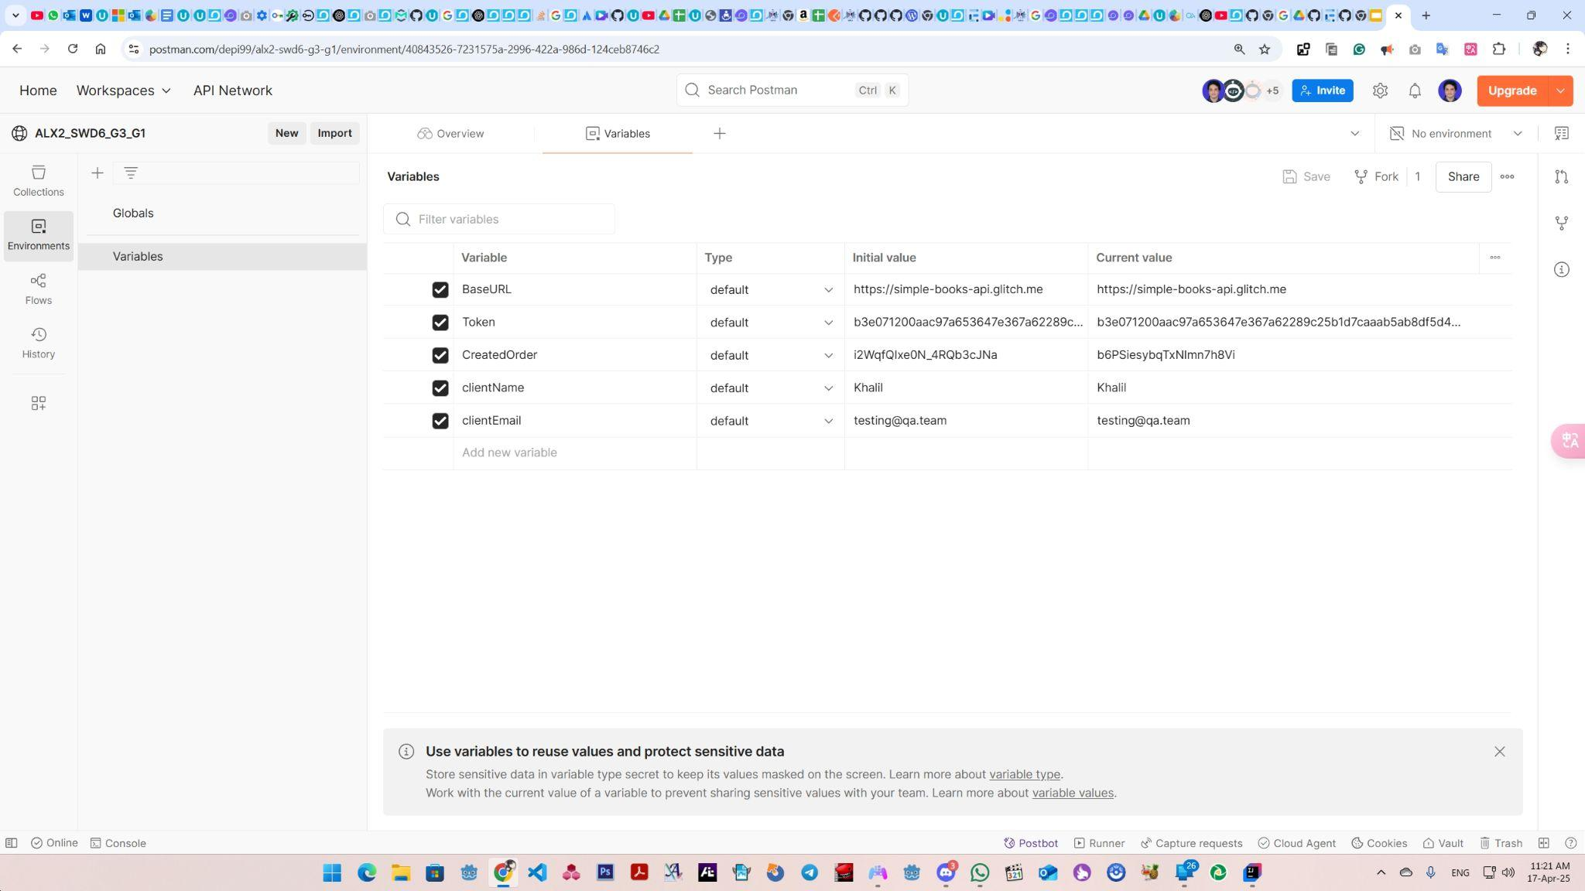
Environment Variables

Slide 69
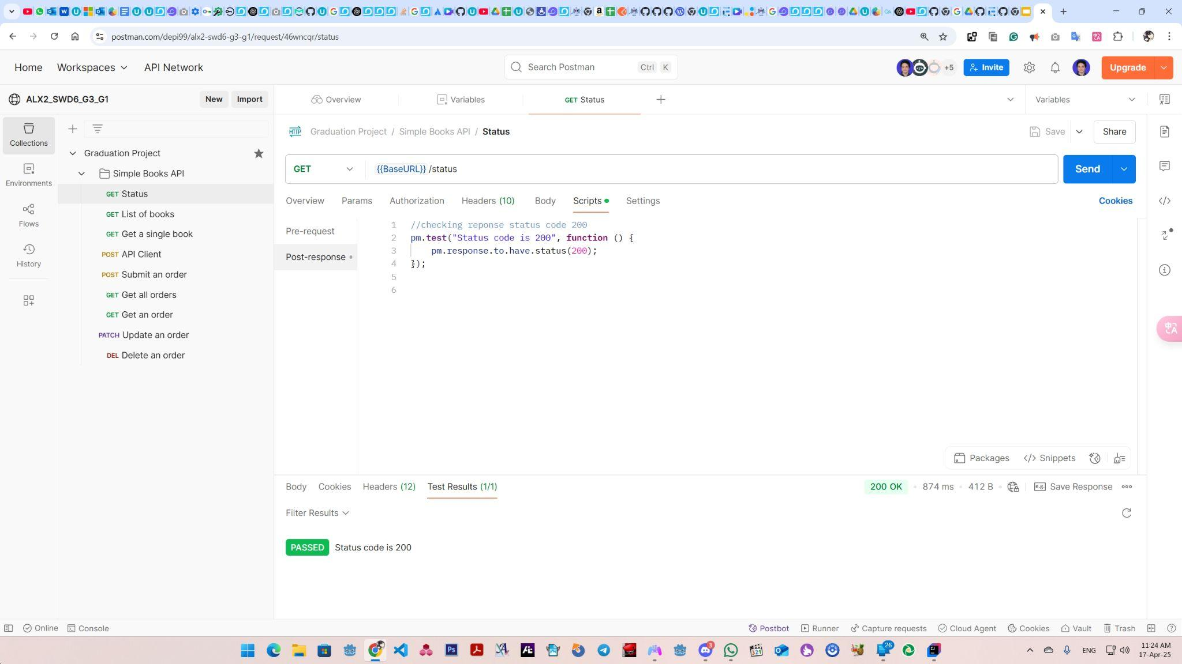
“GET” Status Request

Slide 70
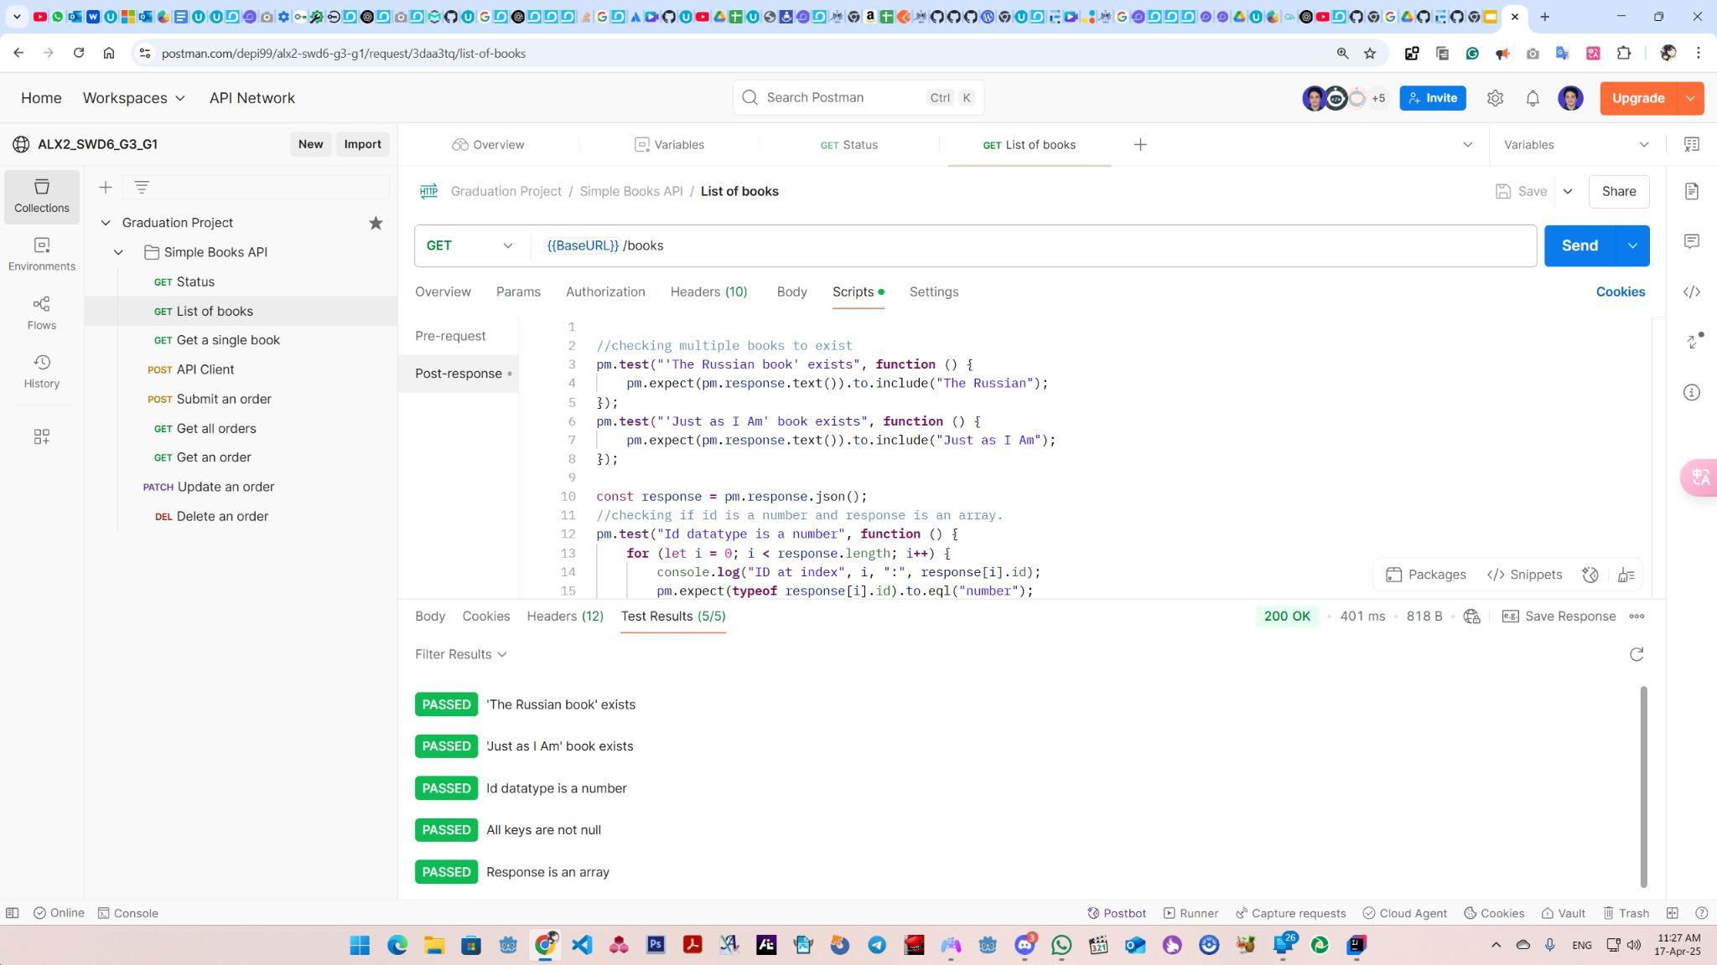
“GET” List of Books

Slide 71
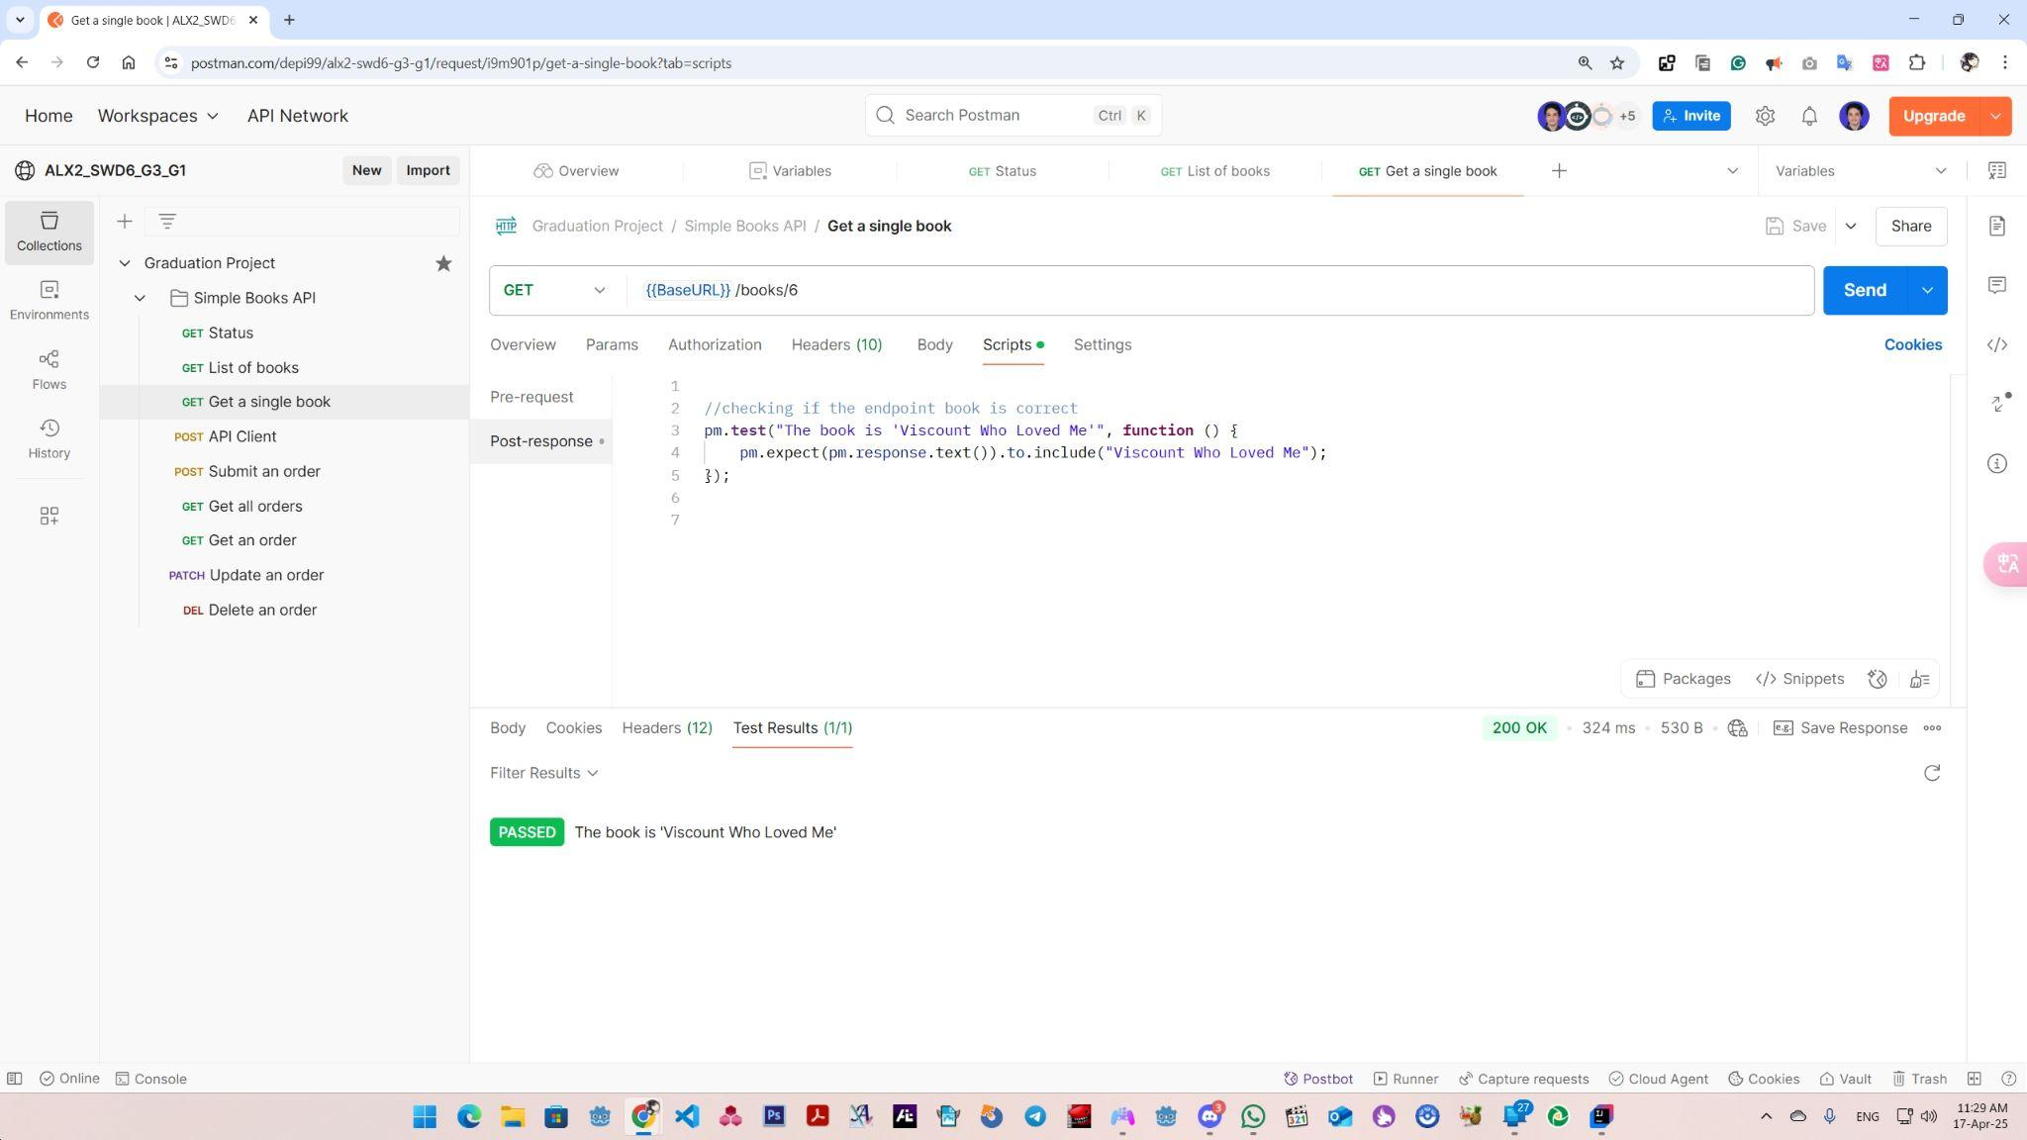
“GET” Get a Single Book

Slide 72
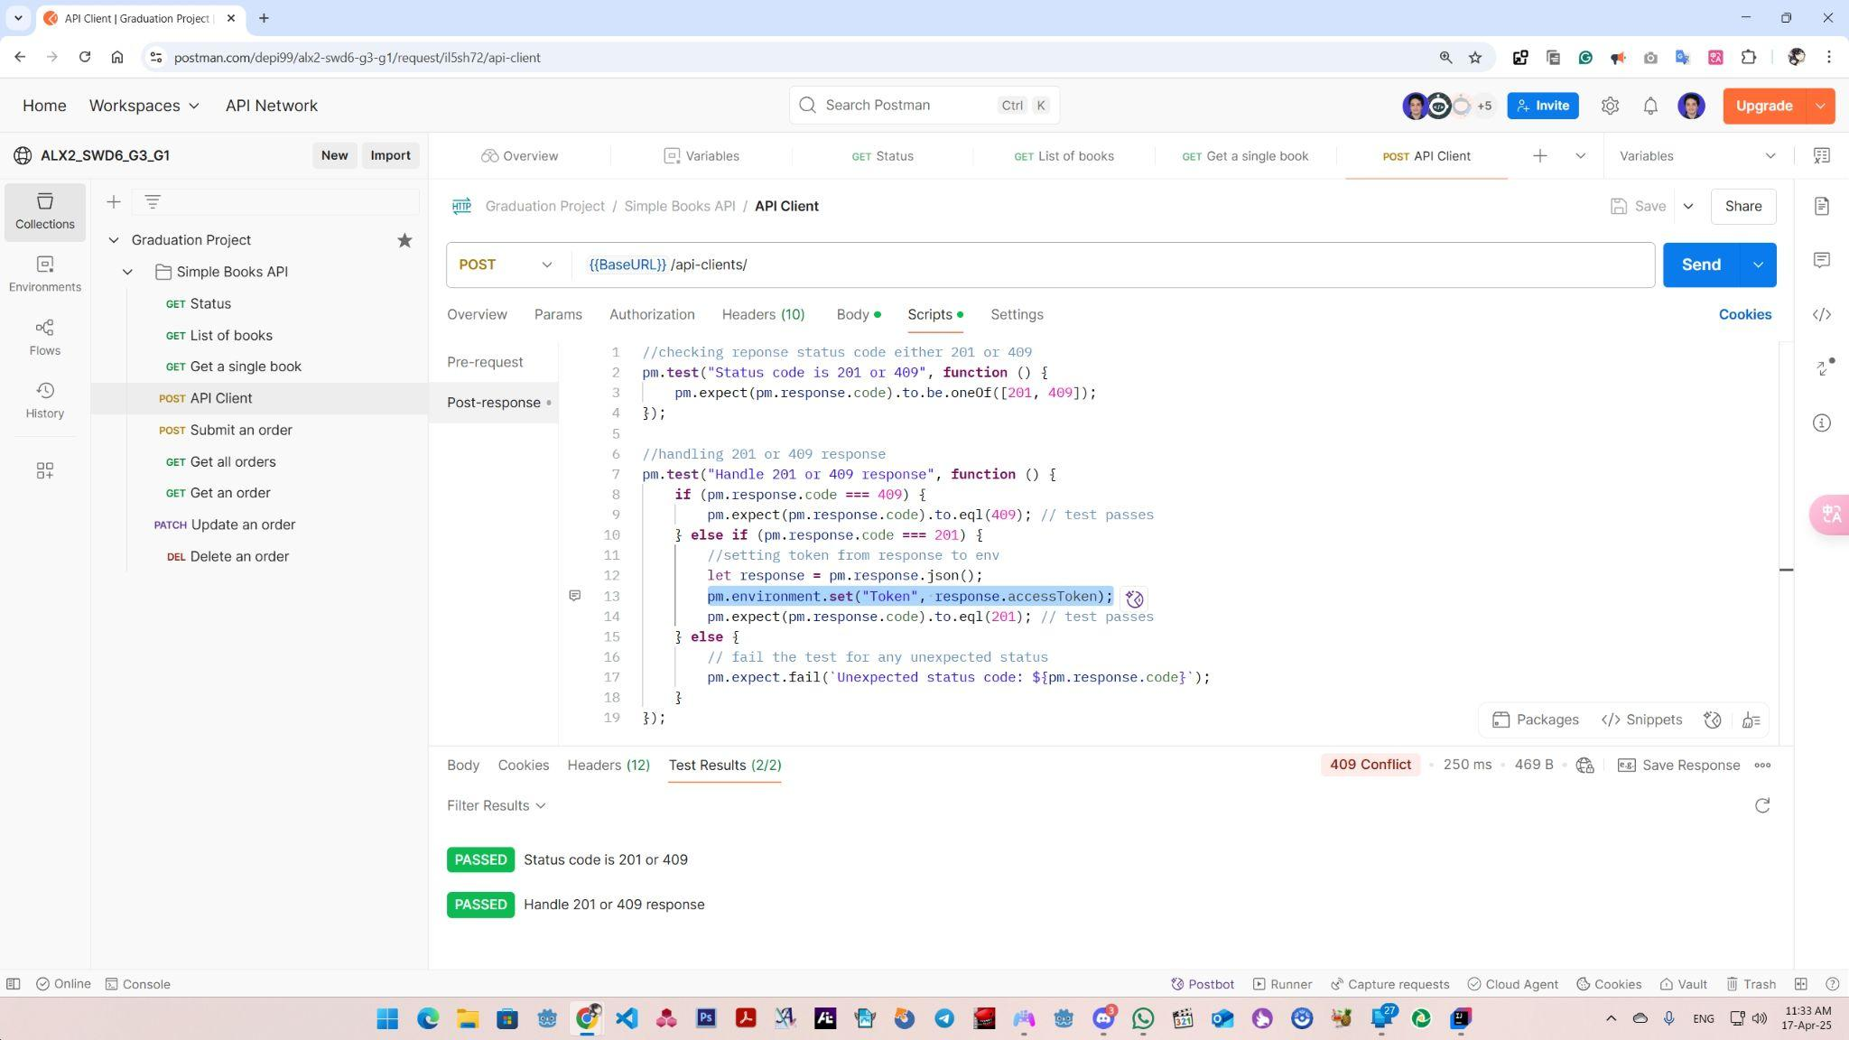
“POST” API Client

Slide 73
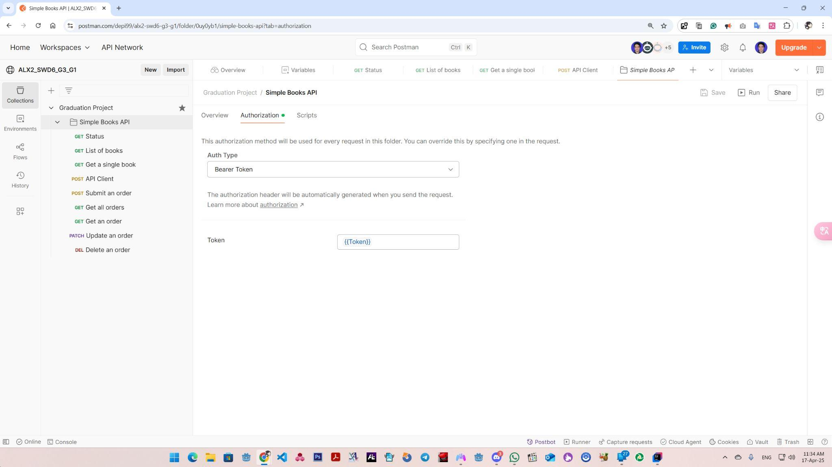
Parent Collection Authorization

Slide 74
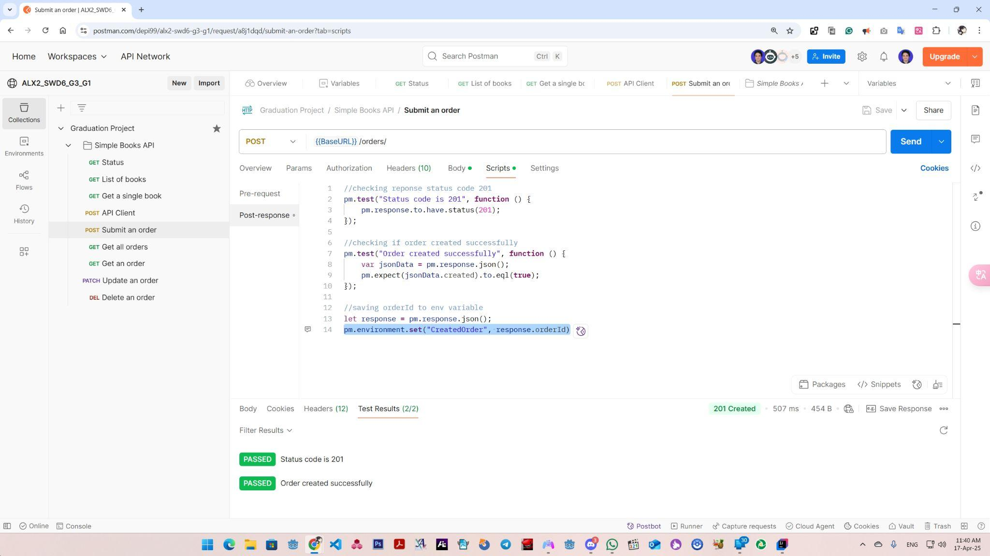
“POST” Submit an Order

Slide 75
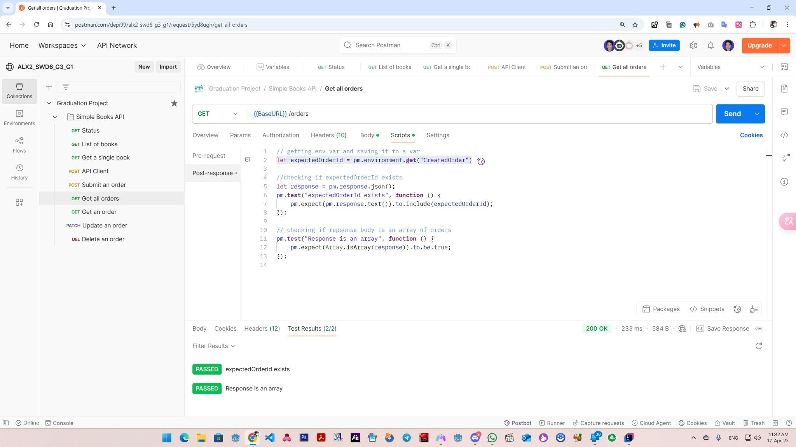
“GET” Get all Orders

Slide 76
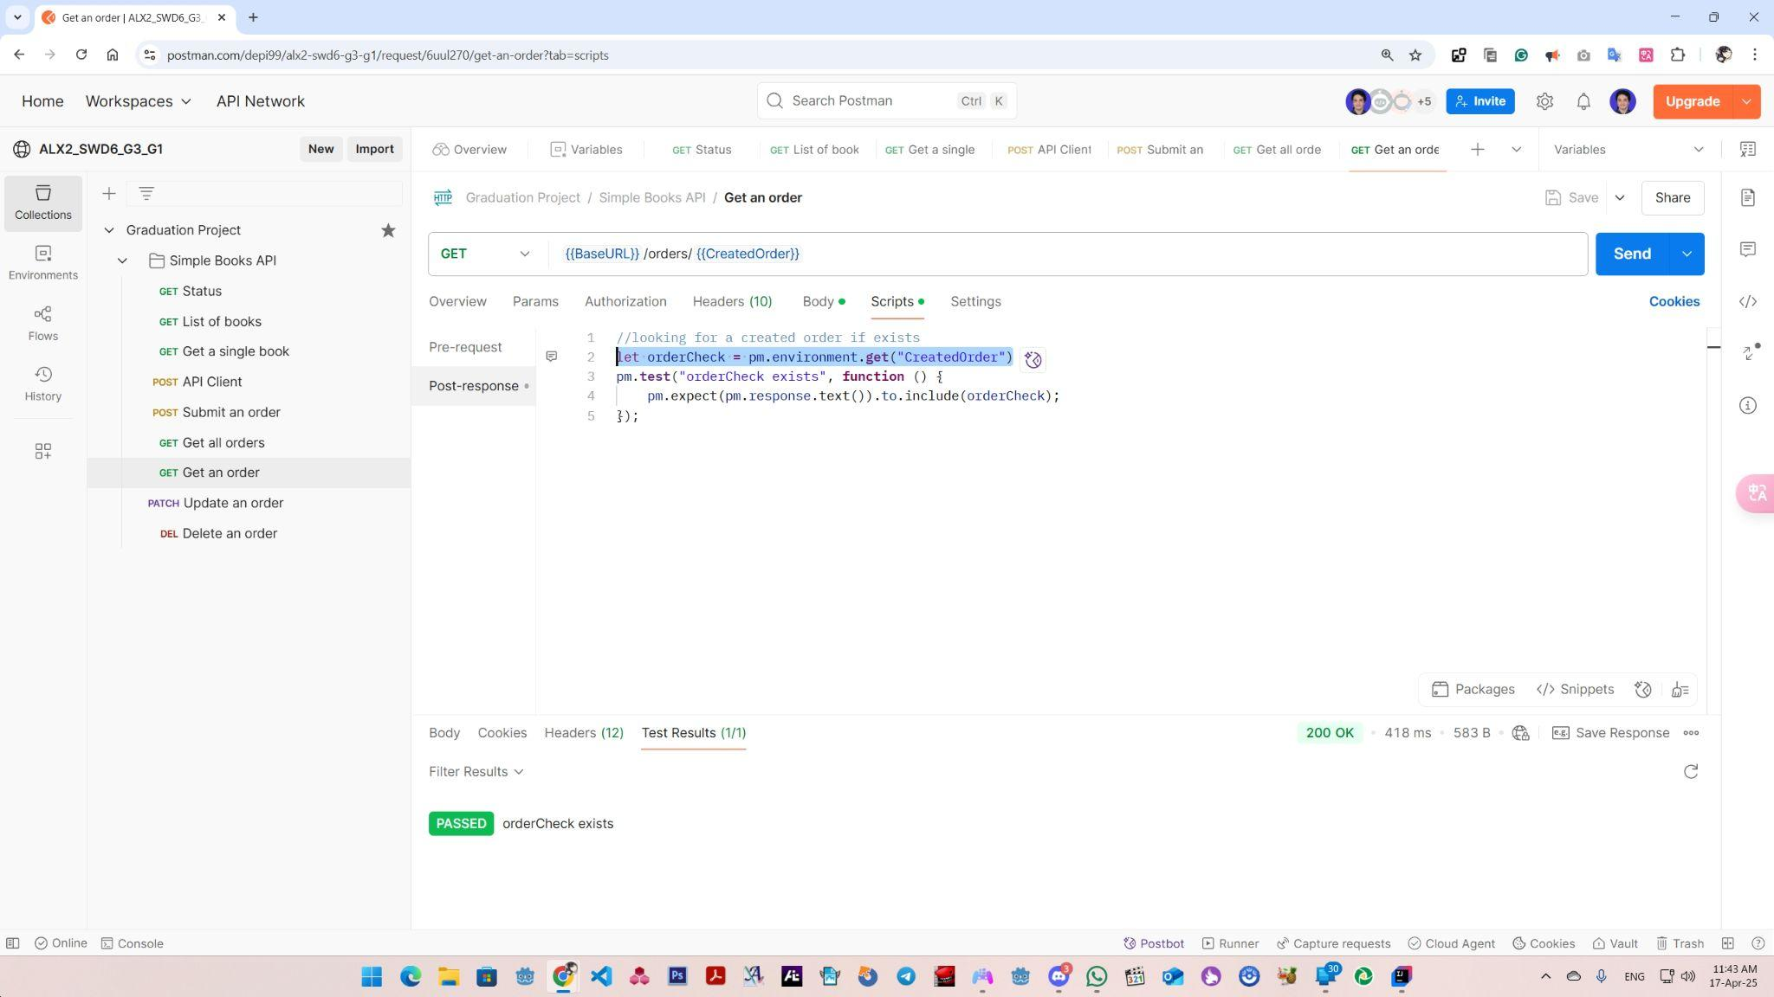
“GET” Get an Order

Slide 77
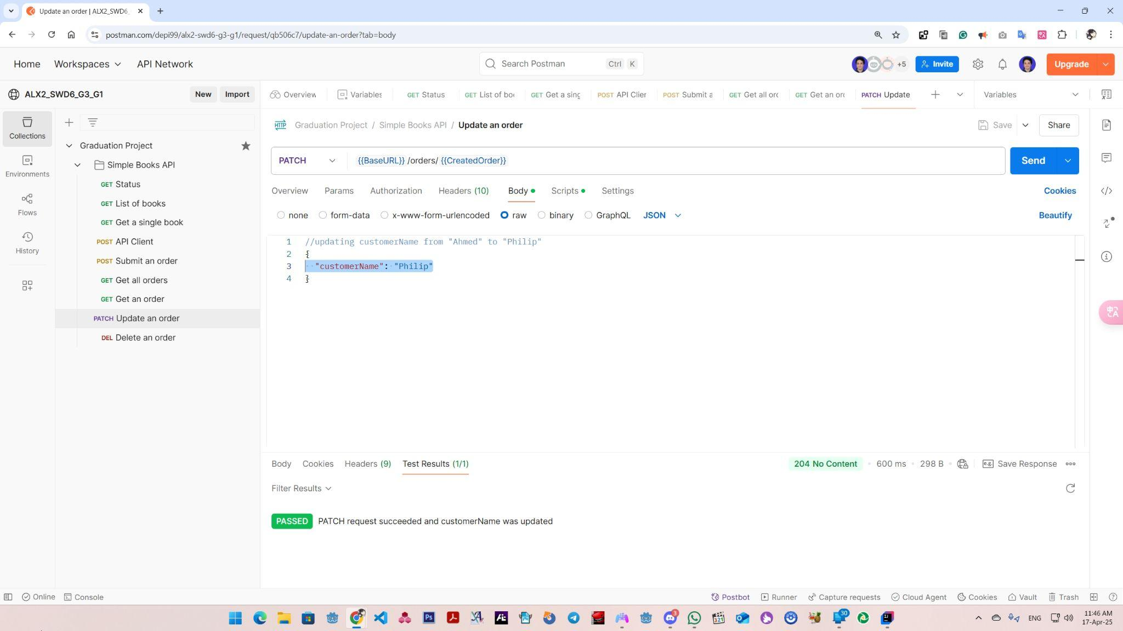
“PATCH” Update an Order (BODY)

Slide 78
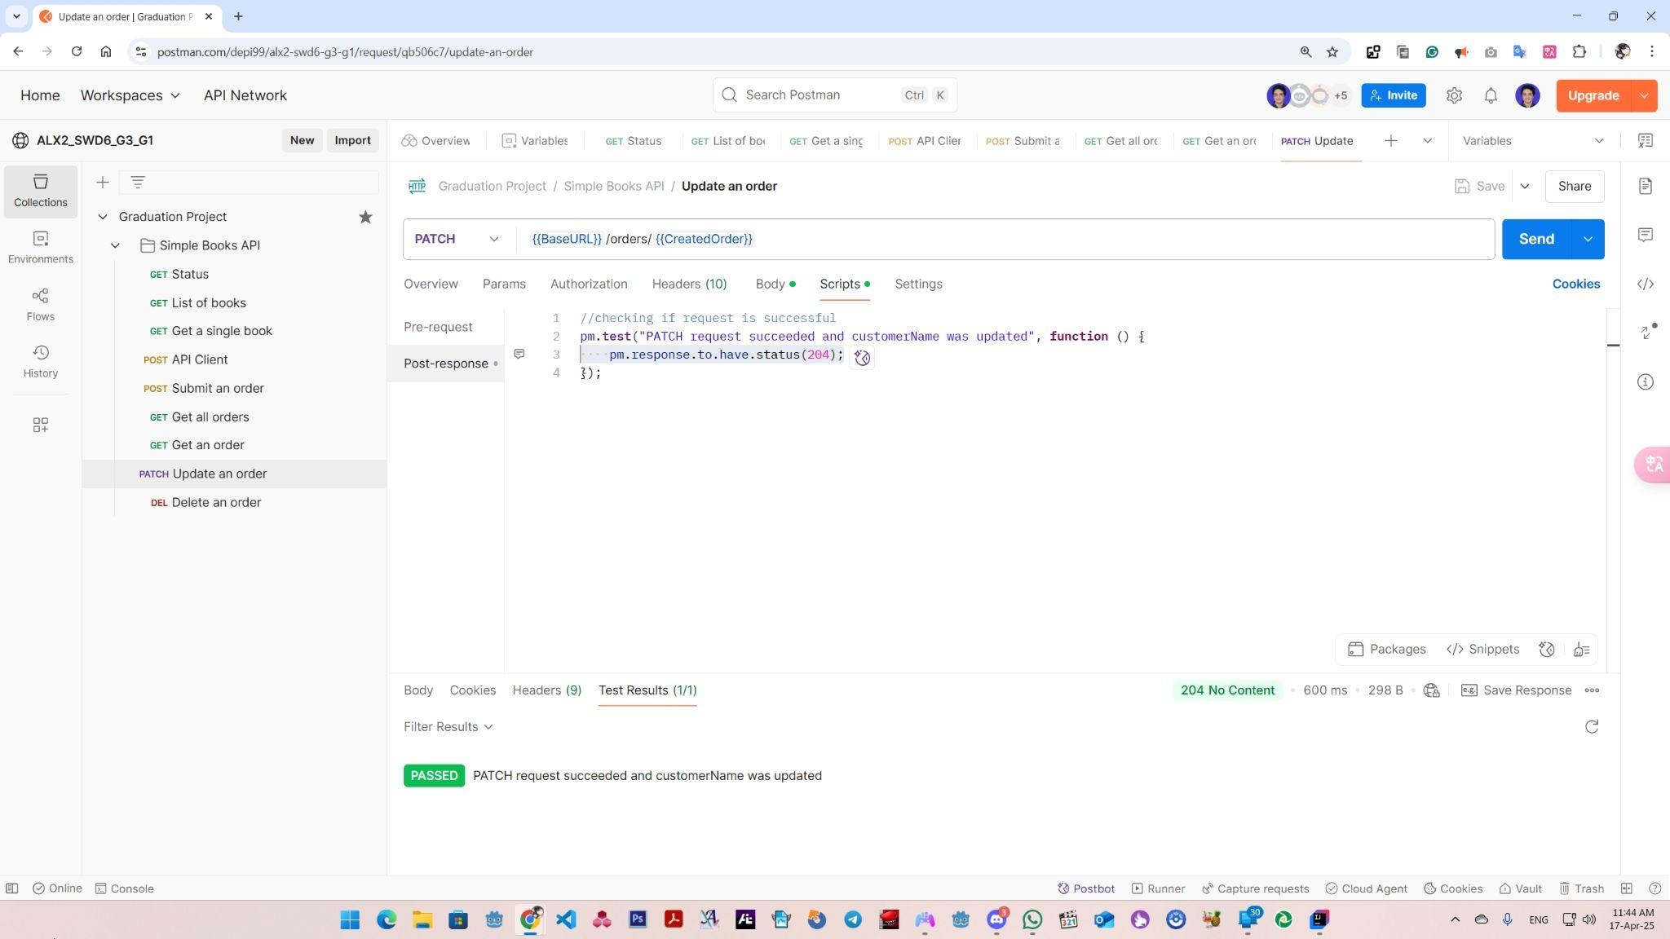
“PATCH” Update an Order

Slide 79
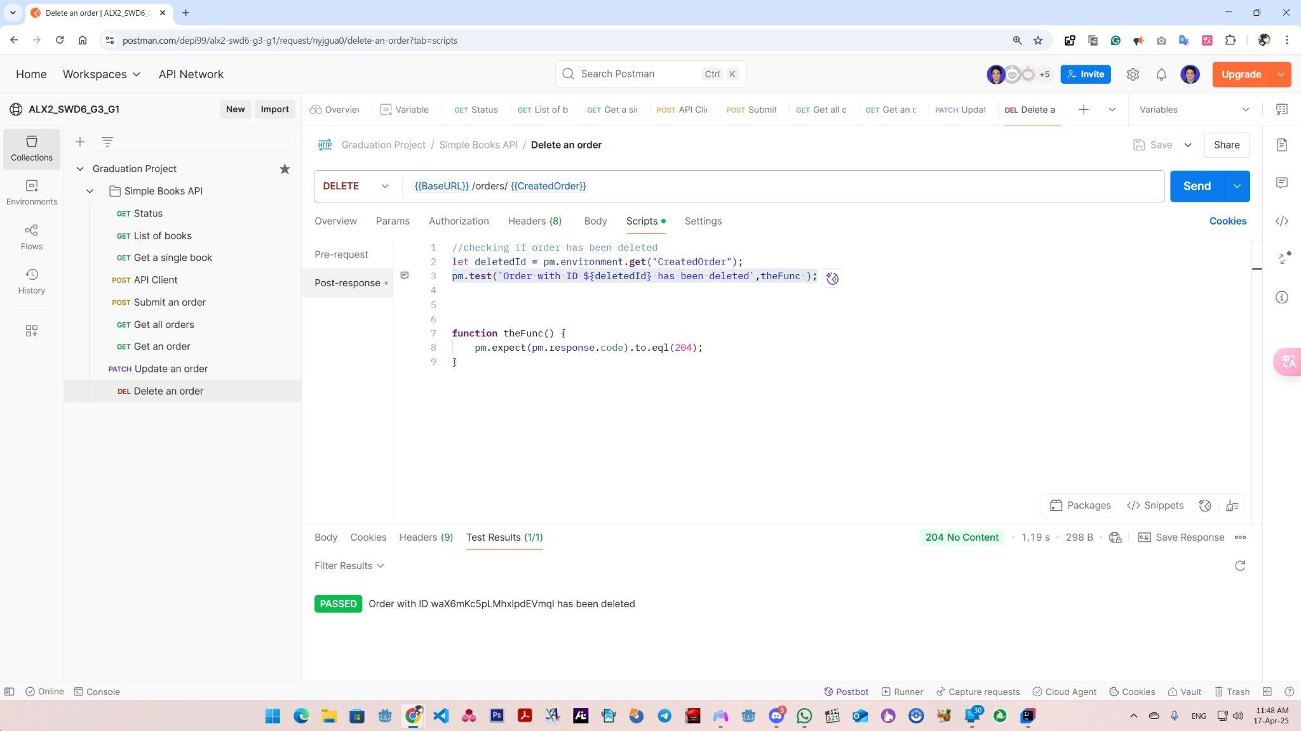
“DEL” Delete an Order

Slide 80
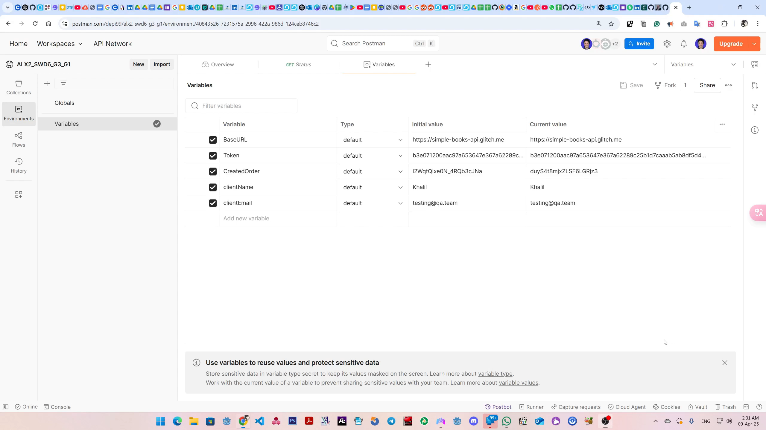
Simple Books API Test Suites Run (VIDEO)

Slide 81


AUTOMATION
FULL AUTOMATION SUITE

Slide 82
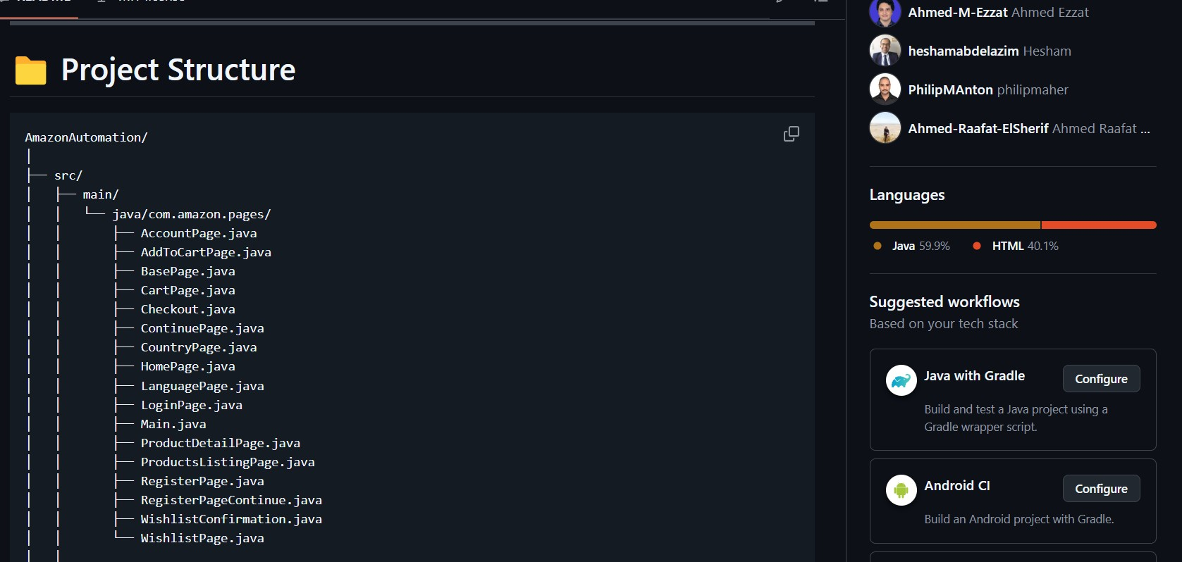
Project Structure in Github

Slide 83
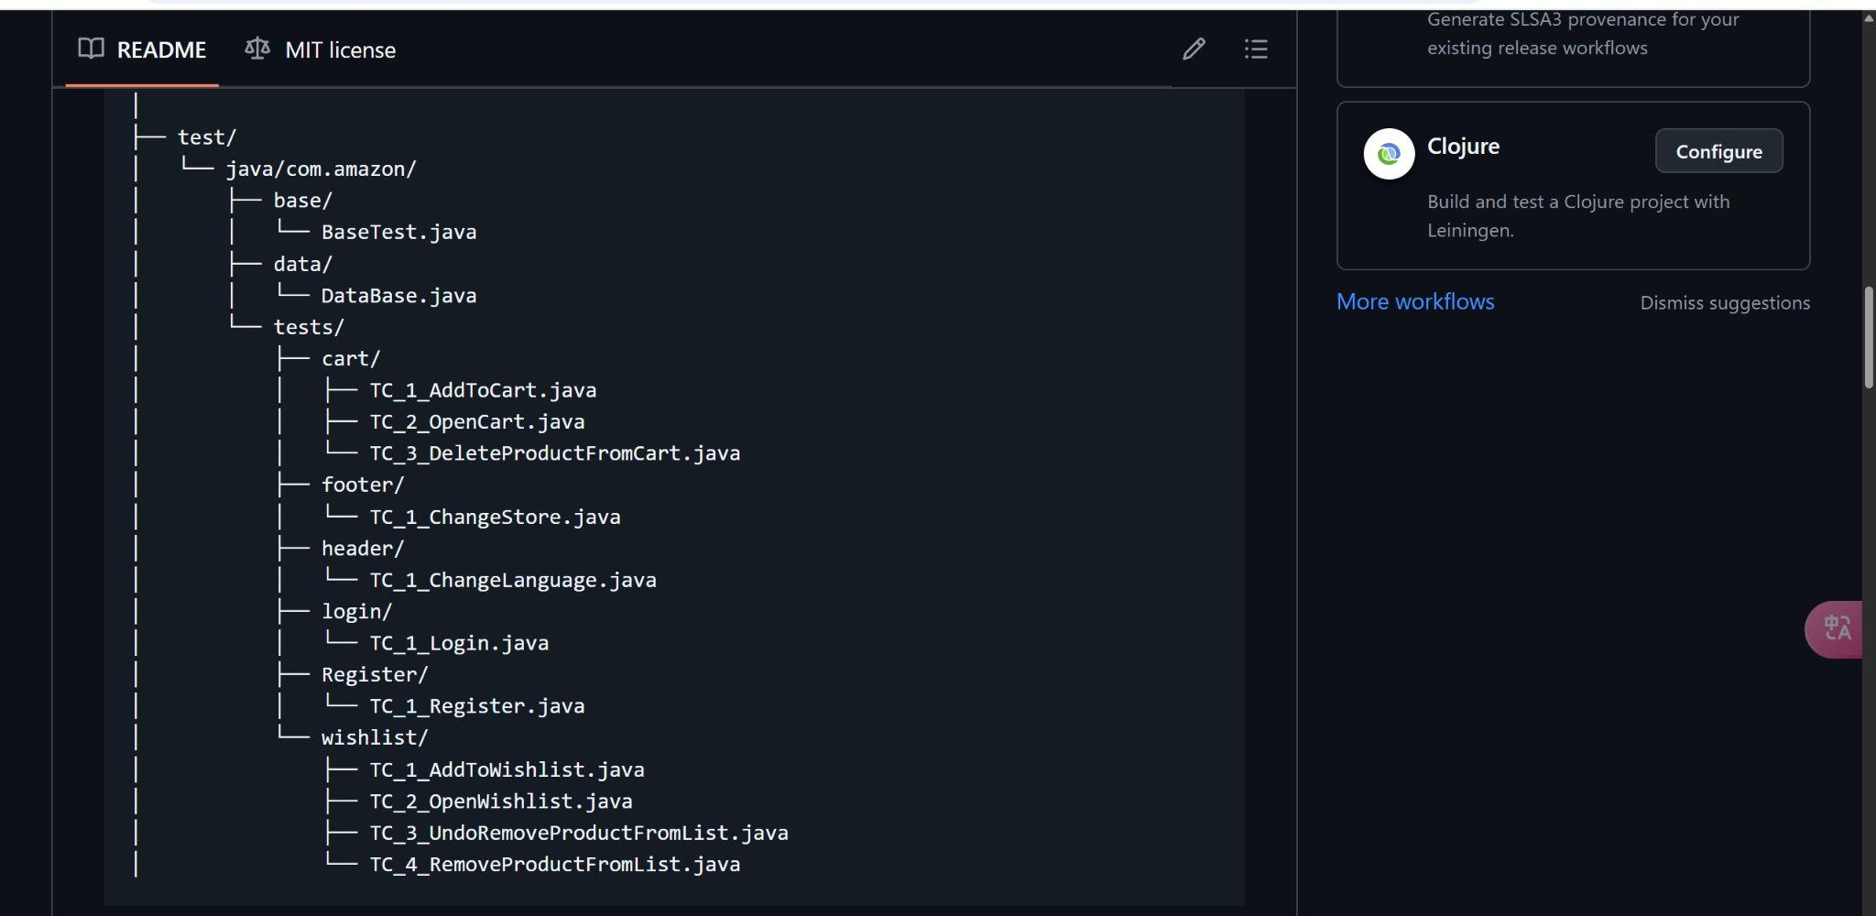
Project Structure in Github

Slide 84
Sample System Design
Parent Base Page
Parent Base Test
Register POM
Register
Test
Static methods

Slide 85
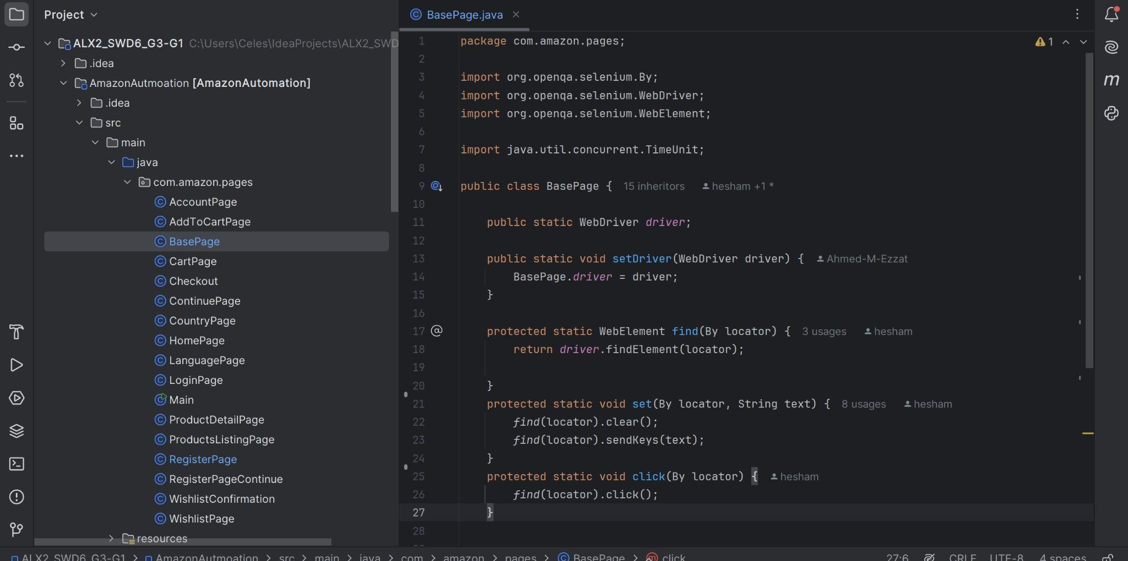
BasePage.java

Slide 86
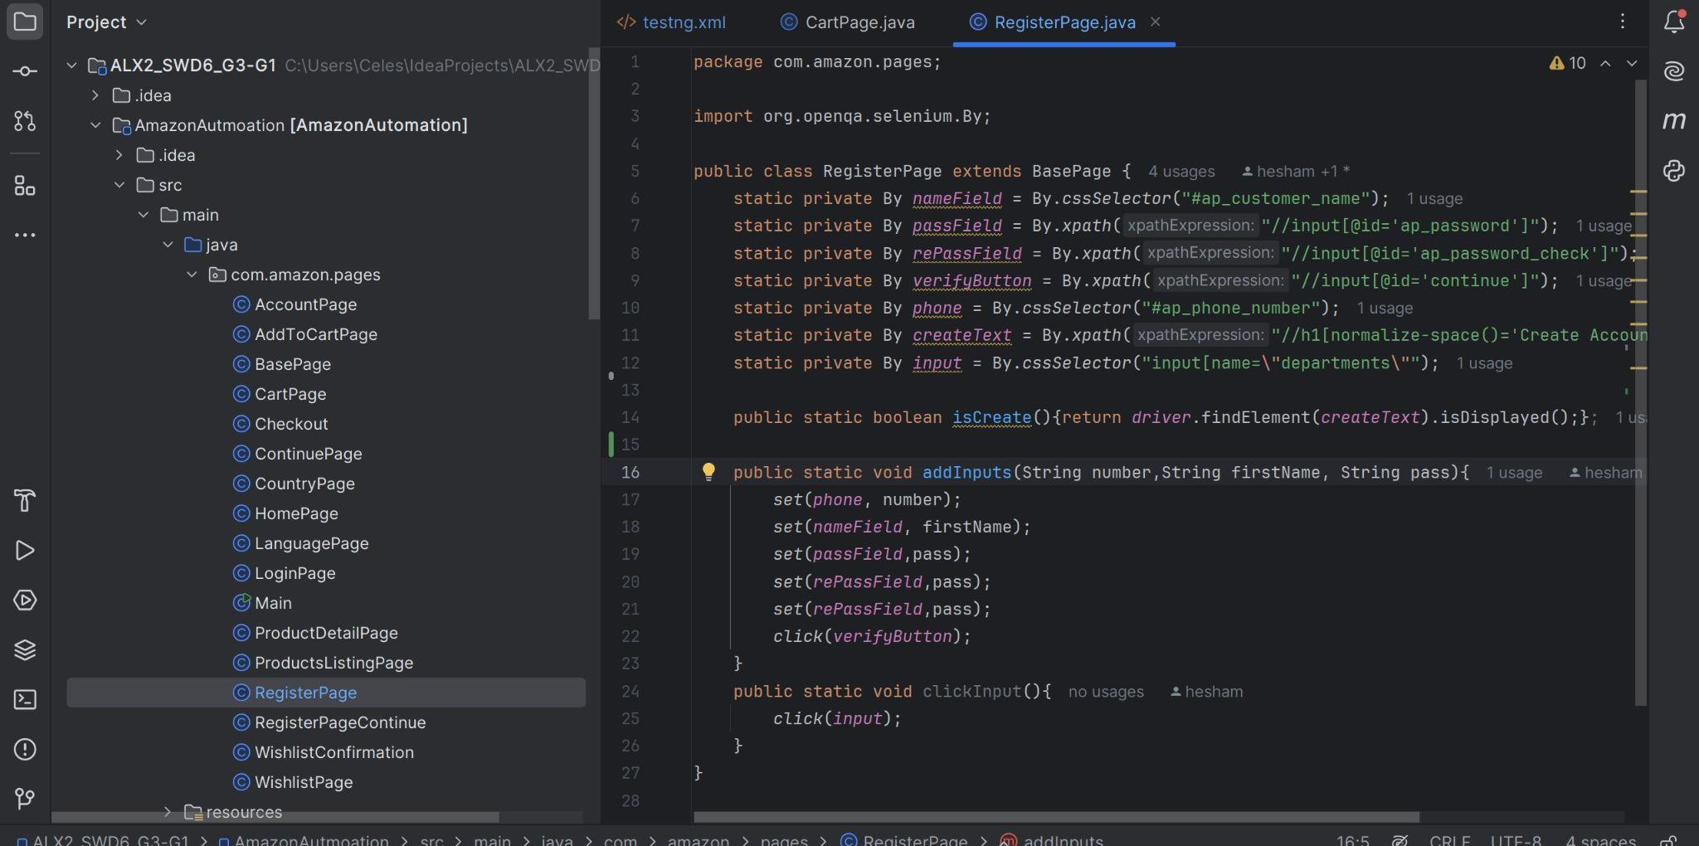
RegisterPage.java (Sample)

Slide 87
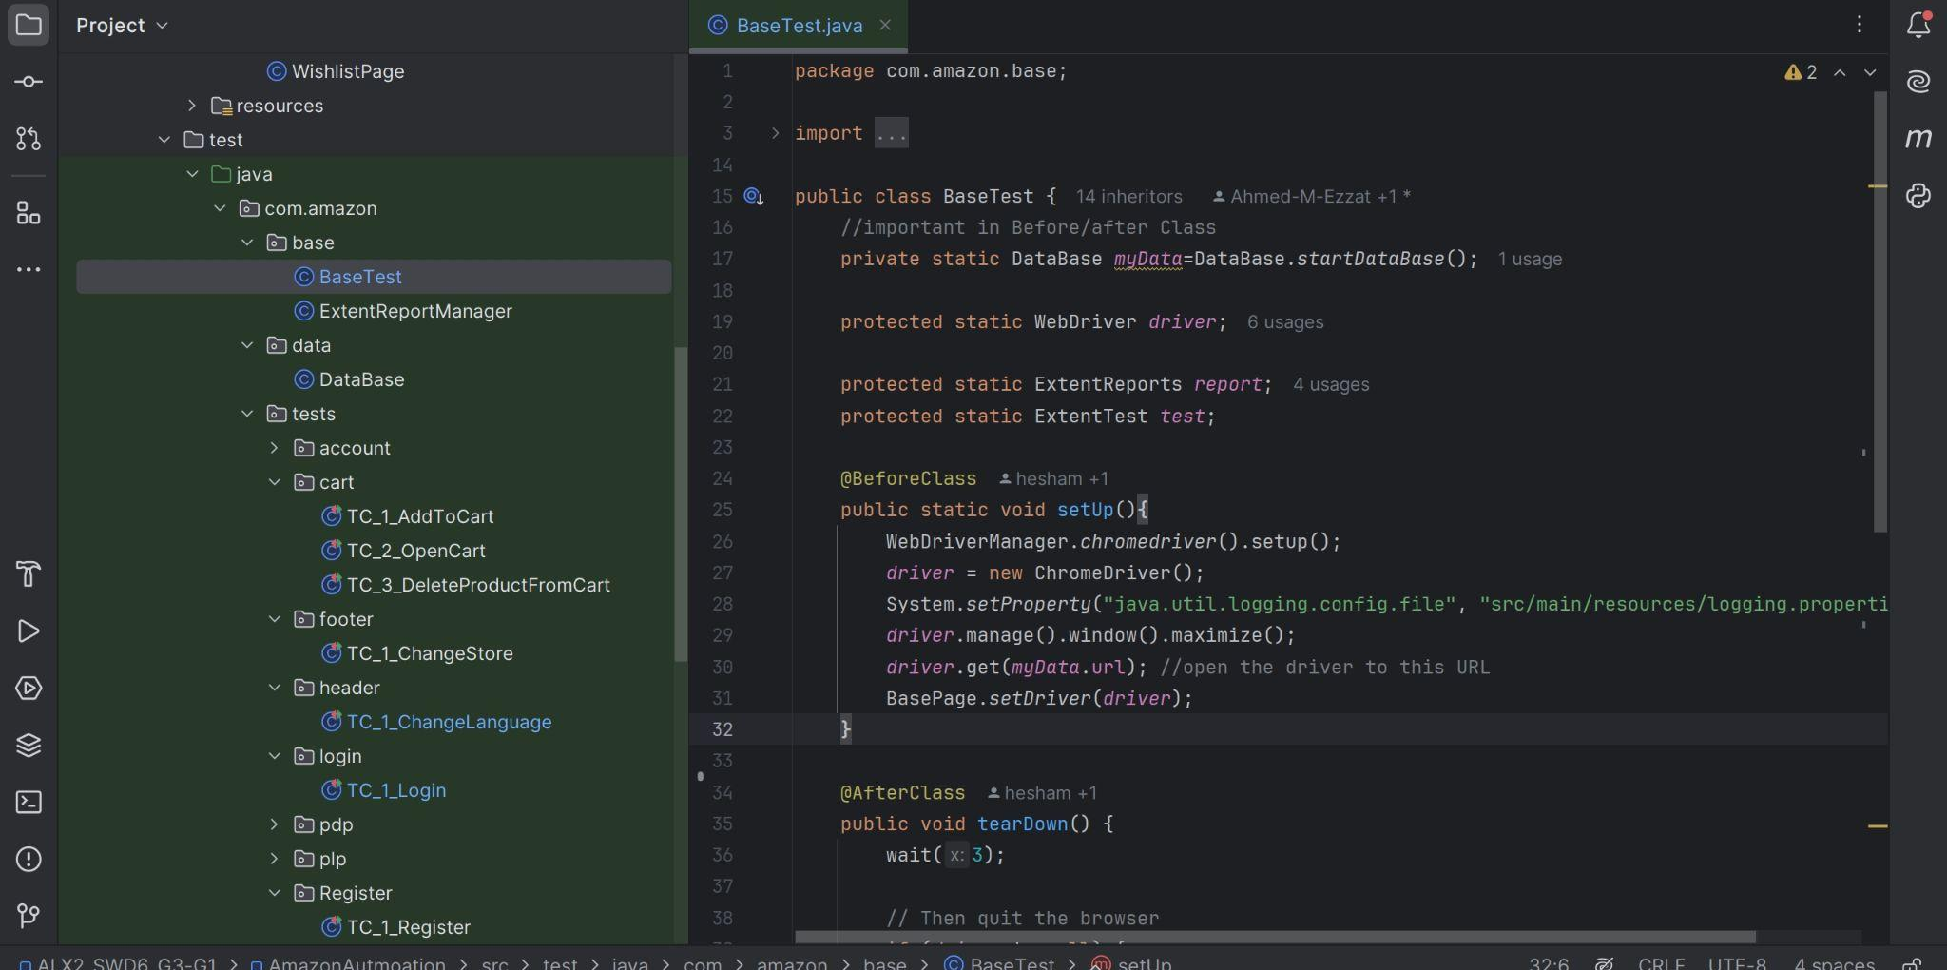
BaseTest.java

Slide 88
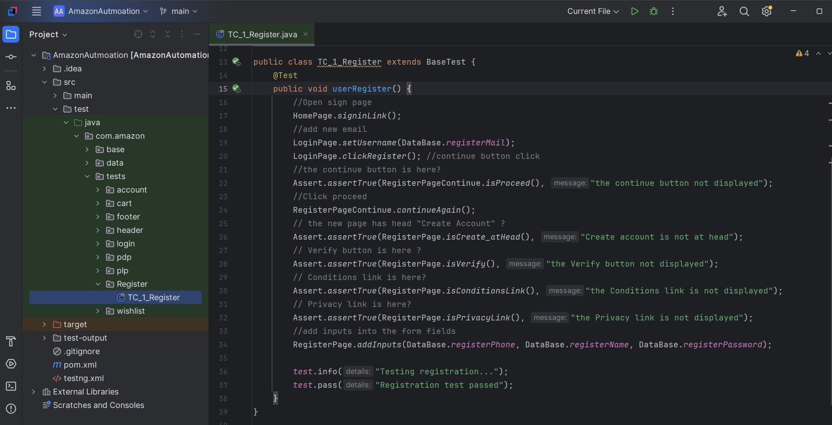
RegisterTest.java (Sample)

Slide 89
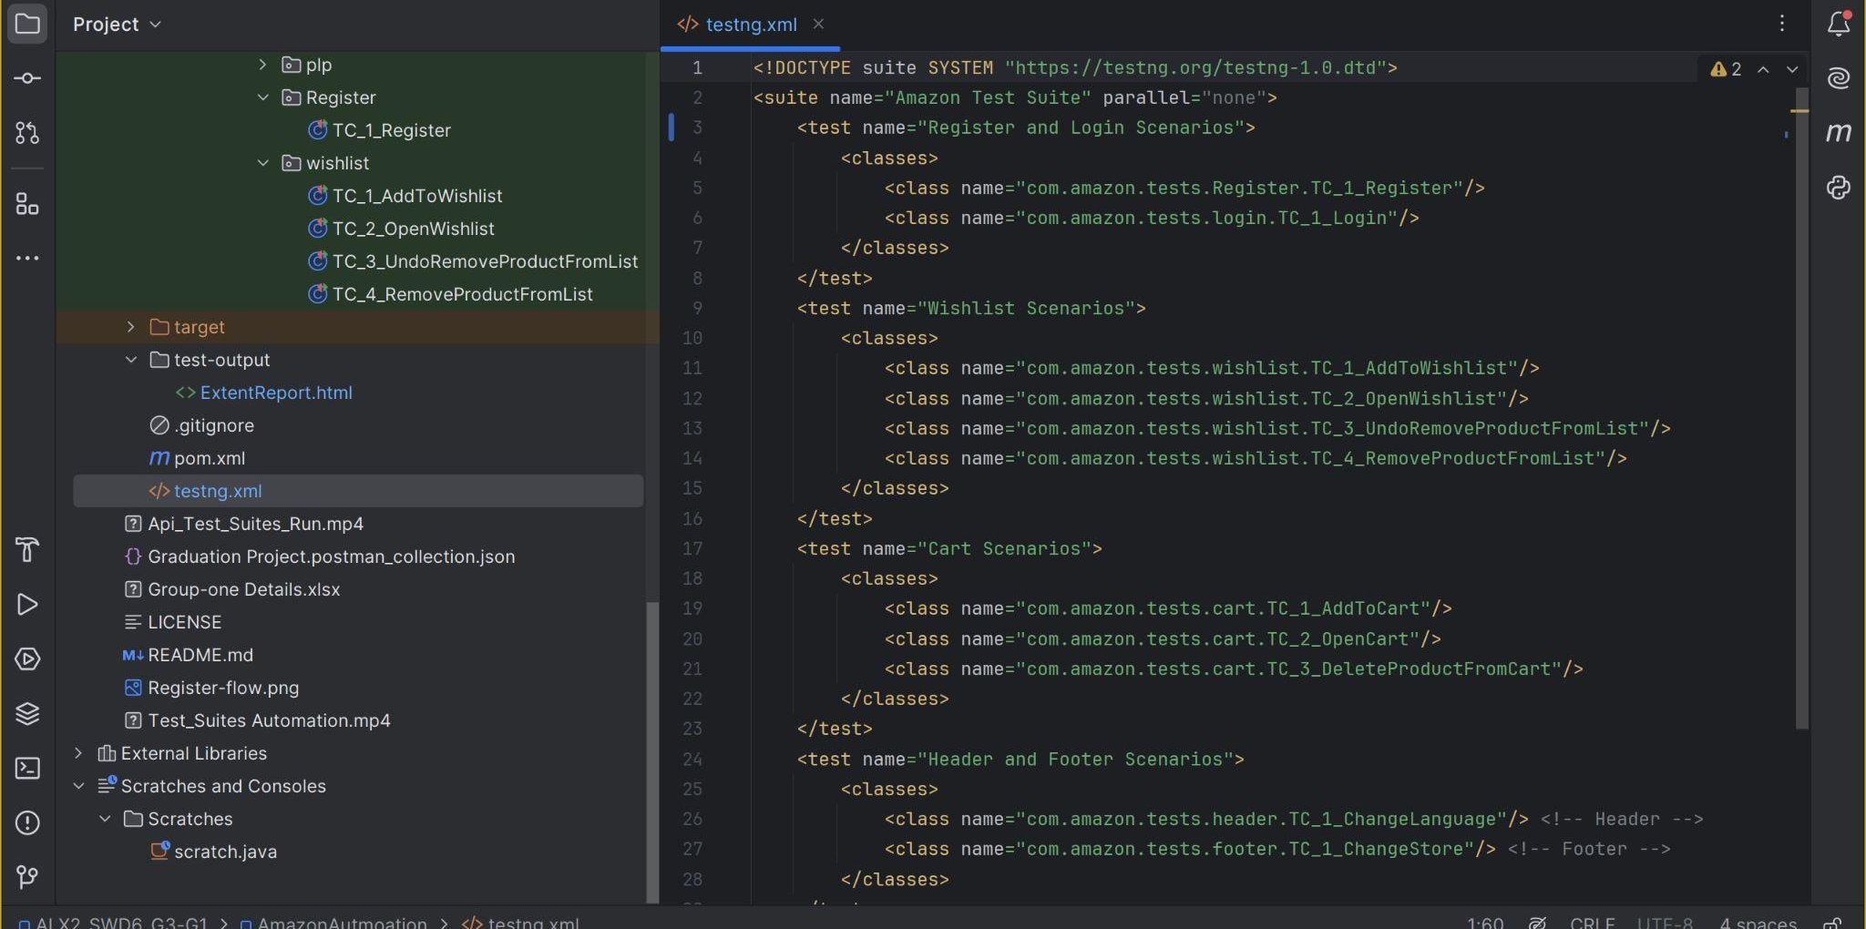
Testng.xml (Automation Scenario)

Slide 90

Full Amazon Web App Test Suites Run

Slide 91
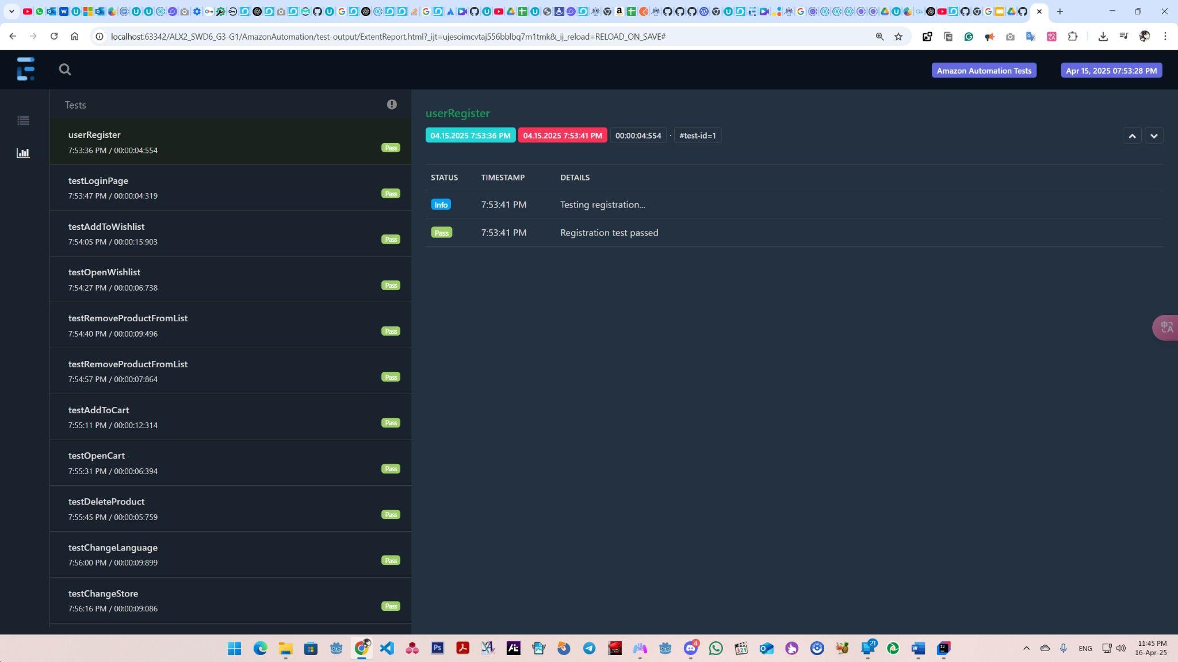
Reports

Slide 92
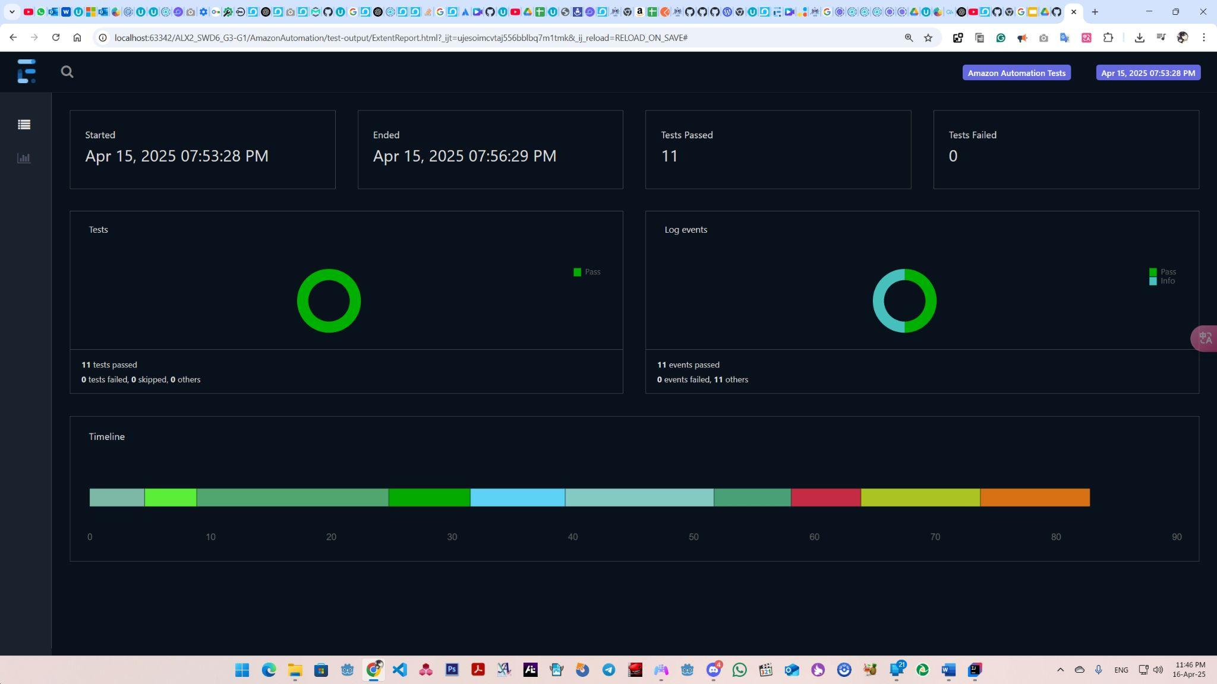
Reports

Slide 93
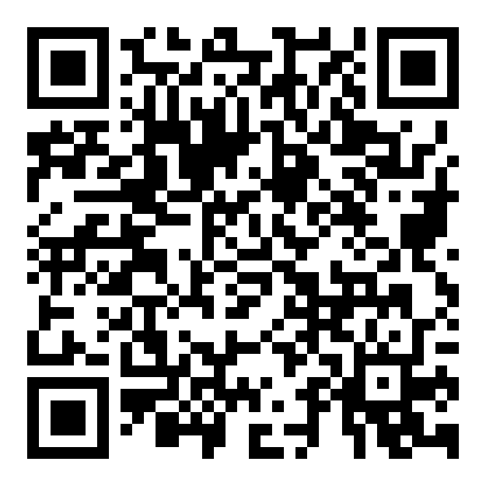
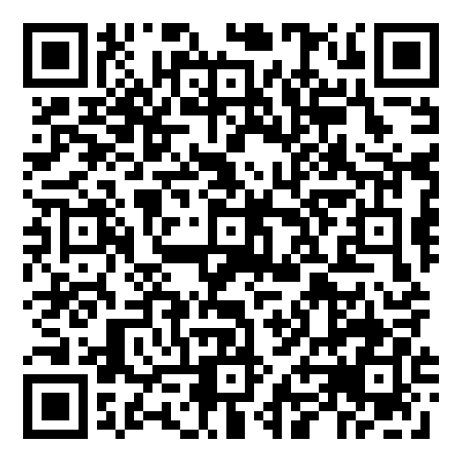
THANK YOU, Any Question?
Amazon Web App Automation GitHub Repo
Postman Simple Book API Endpoint Collection

